Slide 1
Running Live Sound
Ryan Gardner
ryangardner@dadeschools.net

Slide 2
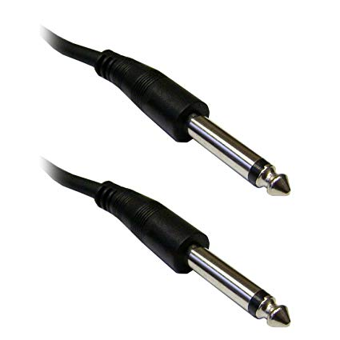
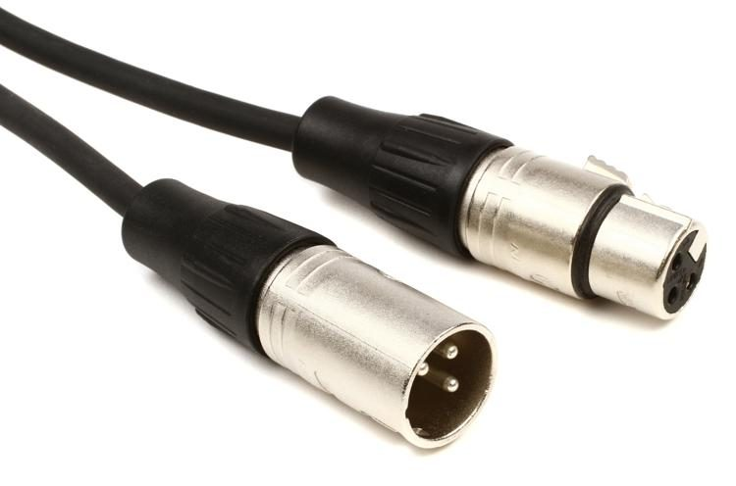
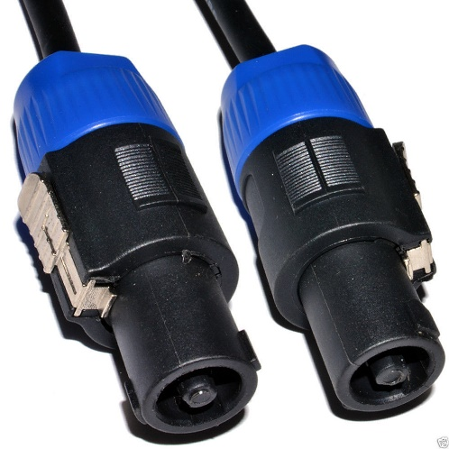
Cable Management
XLR Cables – around $10-$15 for a 25-foot cable
Mostly used for speakers and microphones
¼” Cables – around $10-$15 for a 25-foot cable
Mostly used for guitars and amplifiers, can be used as an insert for some wireless microphone systems and for monitors/speakers.
Speak-On Cables – around $25-$30 for a 50-foot cable
Used to plug in certain speakers to a mixer
¼ Inch XLR Speak-On

Slide 3
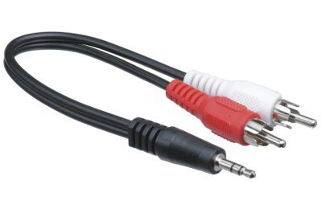
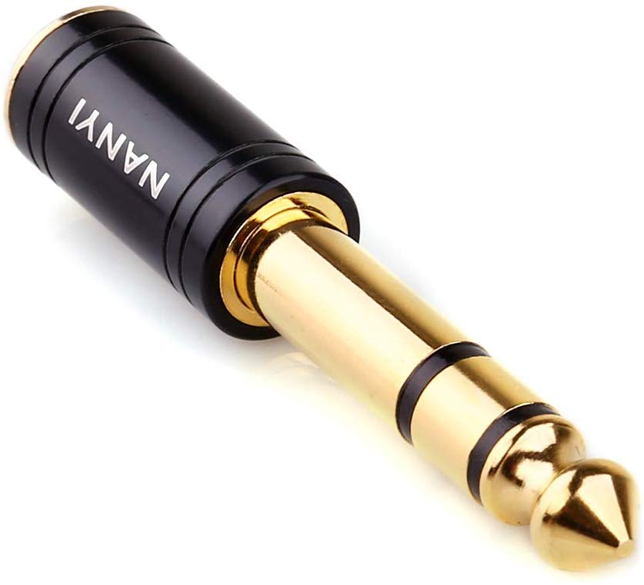
Basic Miscellaneous Cables/Adapters
3.5mm Stereo Male to Male RCA (Used for plugging in audio devices such as IPAD, CD Player, etc.)
¼” male to 1/8” female adapter

Slide 4
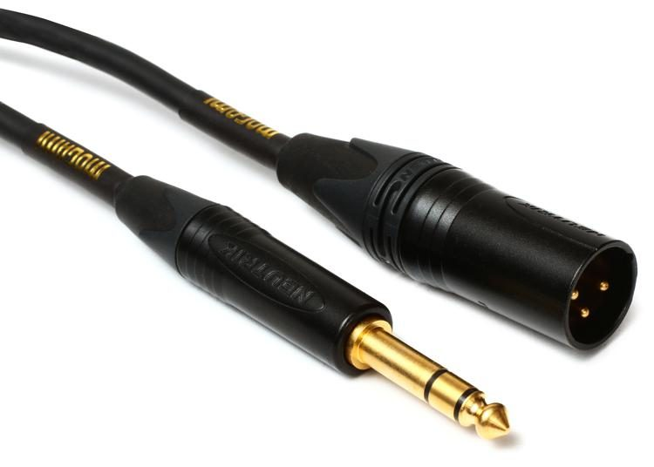
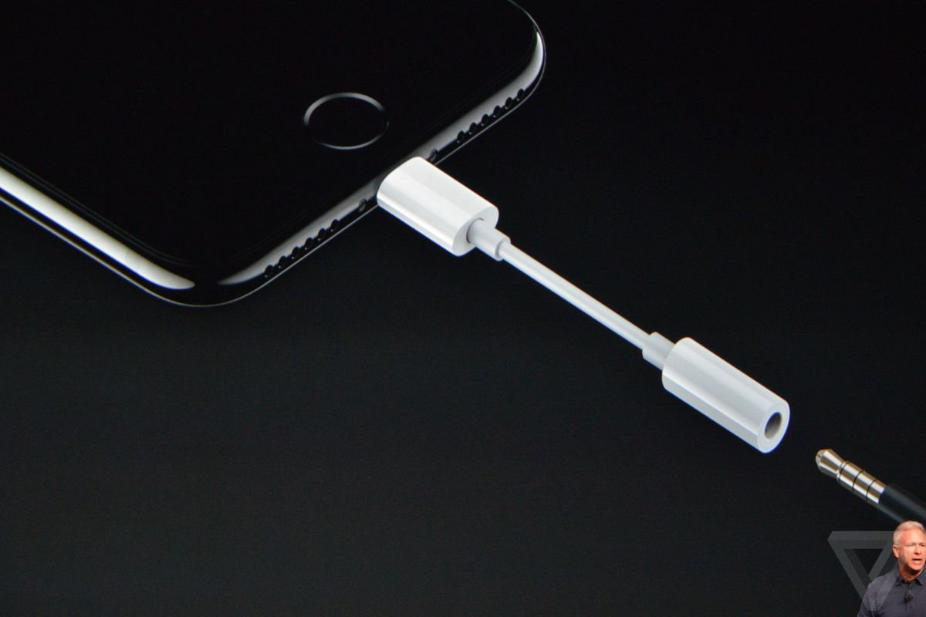
Basic Miscellaneous Cables/Adapters (contd.)
¼” male to XLR Male/Female
iPhone lightning cable to 3.5mm

Slide 5
Cable Management (Contd.)

Slide 6
Dynamic Microphones
Dynamic Microphones
Best for: Powerful (direct) Vocals, capturing strong/loud sounds
Set-up: Close proximity to sound source
Common makes+models
Industry standard: Shure SM57 and Shure SM58
Cheaper Alternatives: Shure PG58-XLR, Sennheiser E835, AKG D5

Slide 7
Condenser Microphones
Require 48v power from sound board (phantom power)
Pencil Condenser Mic (Usually sold in pairs):
Best for: Large group ensembles (vocal or instrumental), drum overheads
Industry standard: Rode NT5
Affordable alternatives: AKG P170, Samson C02PR, Rode M5-MP
Large-Diaphragm Condenser Mic
Best for: vocals/spoken word, solo instrument
Options: MXL 2003a, Blue Spark, Rode NT1-A, Blue Bluebird

Slide 8
Miscellaneous/Specialized Mics
Supercardioid Dynamic Kick Microphone (Drum Set Bass Drum)
Options: Shure BETA 52A, Audix D6, Sennheiser e602 II
Boundary Microphone (Most commonly used for pianos; also can be used to pick up room sound
Options: Audio-Technica Pro 44, Audix ADX60, Shure MX391
Headset Microphones (Solo vocals/speaking with movement) ***Unless you want to be restricted by the wires, be sure it comes with or is compatible with a wireless body pack.***
Options: Shure SM31FH, Audio-Technica ATW1101H92 System10 Pro92cW

Slide 9
Wireless Microphones
Has a wireless receiver that needs to be plugged into the sound mixer (usually XLR cable but can also be ¼” cable)
Microphone and receiver need to be set to the same frequency band
Wireless receiver has it’s own independent volume knob
Microphone is battery operated

Slide 10
Sound Mixers Basics
Unpowered mixers need powered speakers
Powered mixers need unpowered speakers
Make sure board includes phantom power (48v)
Check cable output type on mixers to make sure your mixer will be compatible with your speakers

Slide 11
Sound Mixers
Powered Sound Mixer:
Usually heavier due to built-in amps, better for permanent performance locations
Requires unpowered speakers
system usually stays connected to speakers and just has to be turned on to be performance ready.
Unpowered Sound Mixer:
Usually lightweight, good for on-the-go performances
Require an external amplifier or powered speakers (need a power cable to turn on the speakers).
Includes more features and effects

Slide 12
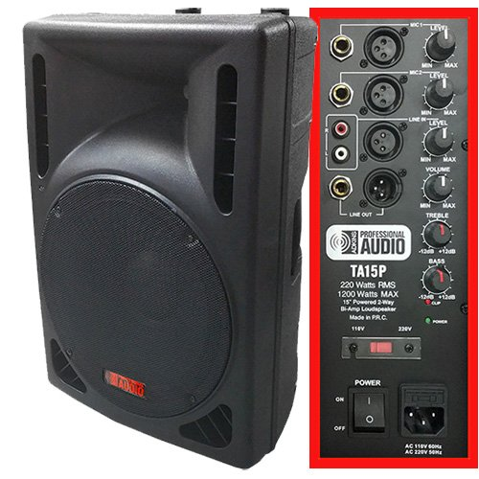
Powered Speakers (a.k.a. active speakers)
Requires a power chord to be plugged in
Has separate volume control from mixer
Usually connects to mixer with XLR or ¼” cables
Works with unpowered mixers

Slide 13
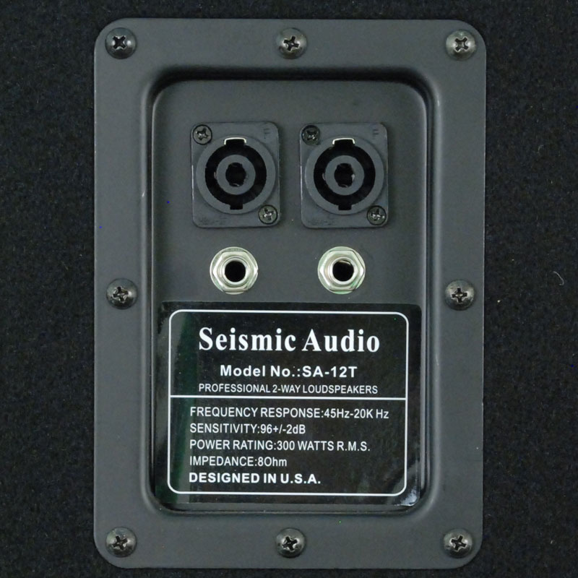
Unpowered Speakers (a.k.a. passive speakers)
Usually connects to mixer with speak-on or ¼” Cables
Does not require a power chord to plug in
Does not have a separate volume control from the mixer
Works with powered mixers

Slide 14
Powered Mixer/ Unpowered Speakers Options
Powered Mixers:
Yamaha EMX5016CF
Behringer Europower PMP2000D
Behringer Europower PMP1680S
Unpowered Speakers:
JBL JRX215
Yamaha CBR15
Mackie Passive Speaker, 600W (C300z)

Slide 15
Unpowered Mixer/Powered Speakers Options
Unpowered Mixers:
Mackie ProFXv2
Behringer Xenyx X1222
Soundcraft EPM Mixer
Powered Speakers:
Mackie Thump12A
Rockville RPG15
Behringer Eurolive B210D

Slide 16
The Anatomy of a Sound Board
Channels
Outputs
Gain
EQ
Mute/Solo
Speaker Assign

Slide 17
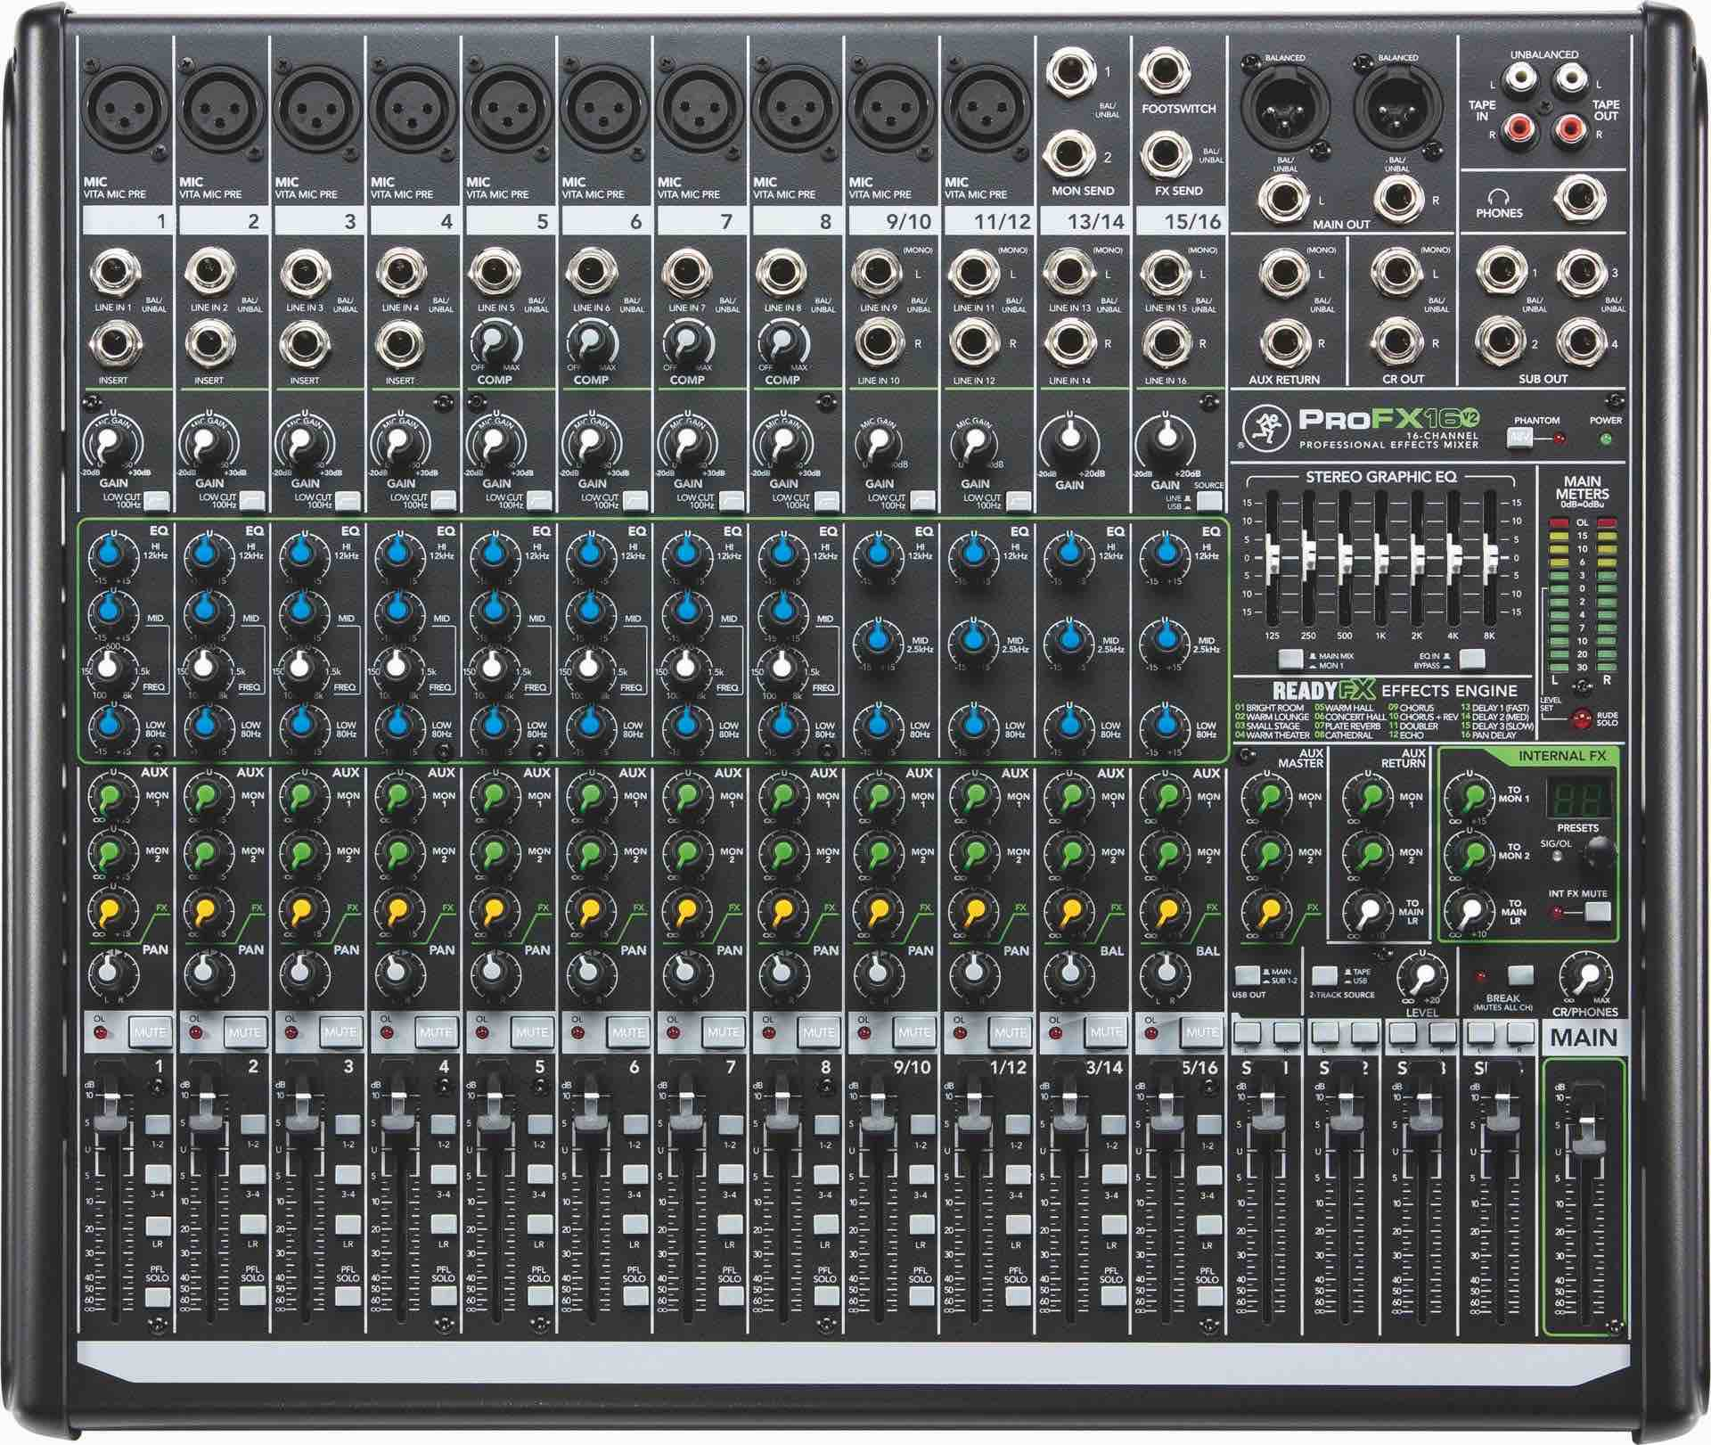

Slide 18
Let’s Talk Channels!
Each Microphone is controlled by a column of controls called a “channel”
The controls for the channels usually include:
Mic input
Line-in/Insert
Mic Gain
EQ
Aux/Fx (Sometimes)
Pan
Mute
Volume Slider

Slide 19
Gain Vs. Volume
Gain: The strength of a signal being inputted into the mixer
The more the gain, the more strength of tone
No processing on the signal yet
Volume: The amount of sound (in dB) that is being outputted to the speakers. This signal is sent out after the signal has been processed.
If you have low gain, and high volume, the overall tone of the outputted signal will be very flat/lacking in tone.

Slide 20
Inserts/Line-ins
XLR Female Port
Line/Hi-Z Button
Hi-Z button rarely used for microphones, mostly used for guitar
Line/Hi-Z In 1
Used to connect something that does not have an XLR option (i.e a guitar, a wireless microphone receiver, etc.)
Insert
For our purposes, this will rarely be used.
Mainly used to add in some type of external effects processor

Slide 21
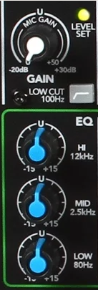
Gain and EQ
The gain knob controls how much signal you want to send into your board before it is processed.
Usually, the higher the gain, the better tone you will get out of your equipment
Equalizers (Eqs)
Controls which frequency of sounds you want to boost or reduce.
LOW EQ: Controls low sounds (plosive consonants, proximity effect, etc.)
MID: Usually the warm part of the speaking voice
High: Usually the higher frequency consonants of the speaking voice (like s)

Slide 22
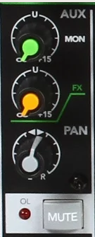
AUX, FX, and Pan
AUX: Used in conjunction with Fx knob.
Taps off channel’s signal so you can send it to an Aux Bus.
Fx knob: controls how much signal has an effect added to it
Pan: Allows you to focus specific instruments to come out of a specific speaker (Left to Right). Changes directionality of sound being outputted.

Slide 23
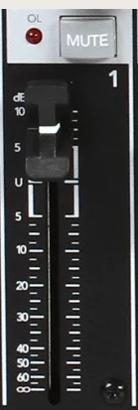
Mute Button and Volume Slider
Mute Button
Not a global mute
Mute’s only the channel on which it lies
Volume Slider
Controls the amount of signal that goes out through the speakers

Slide 24
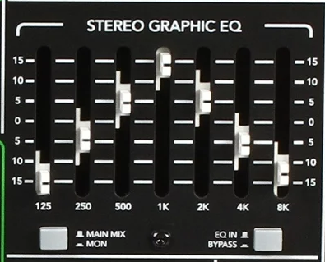
Stereo Graphic EQ
Can be used for a more focused overall control on low/mid/high frequencies
I normally control my EQs on the individual channels. The only time I use the stereo graphic EQ is when I am playing music through the sound board
Safe to set each frequency range to the middle (0)

Slide 25
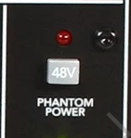
Phantom Power
Usually found either next to the main meters or as a smaller switch in the back of the board next to the power switch
If this is not on, condenser microphones will not work

Slide 26
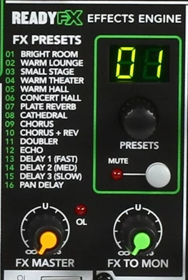
Fx Control
Used to add effects, mainly reverb, onto vocal microphones
Effect can be directed to specific channels using the Fx knob on each individual channel
Different types of reverbs can be selected by turning the preset knob to the number desired
Fx to master
Sends signal with effects to the slide control for the speakers
Fx to monitor
Sends signal with added effects to the slide control for the monitors

Slide 27
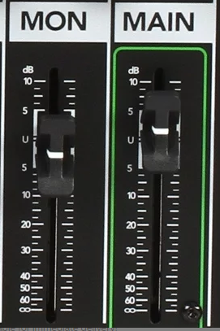
Master Volume
Main
Controls the amount of signal that is sent to the speakers that are plugged into the “main out” ports
Mon
Controls the amount of signal that is sent out to the monitors that are plugged into the “monitor out” ports

Slide 28
Mic-ing a Large Ensemble

Slide 29
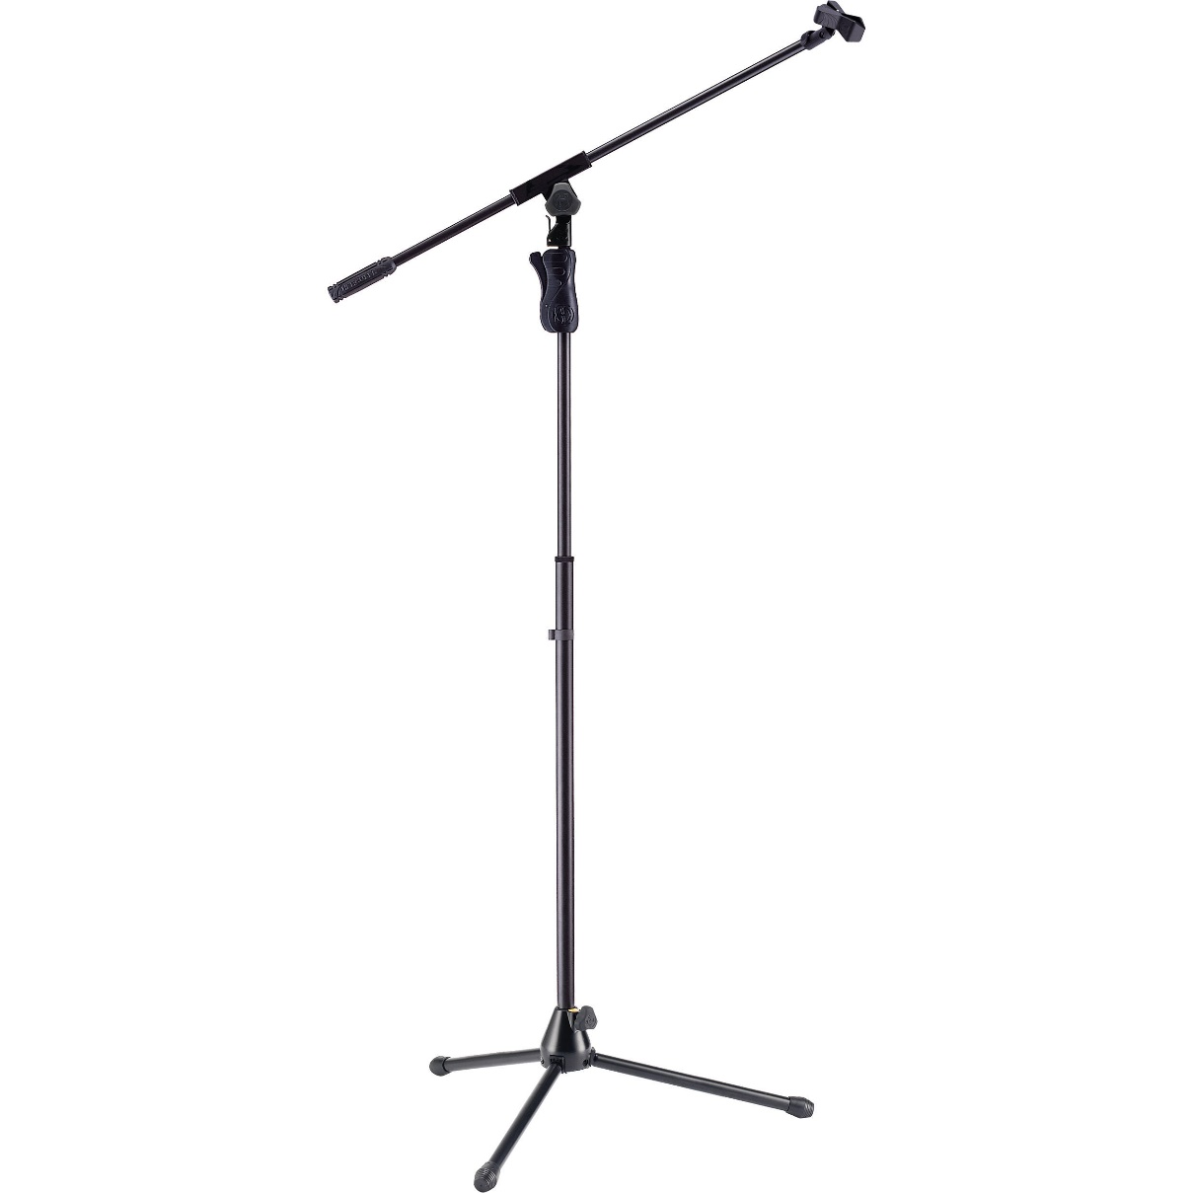
Mic Stands
Tripod Boom Stand
Good for mic-ing individual acoustic instruments
Better overall mobility for Mic placement

Slide 30
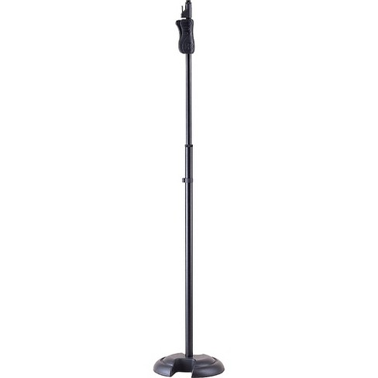
Mic Stands
Round-Base Stand
More sturdy
Less Flexibility in terms of mic placement

Slide 31
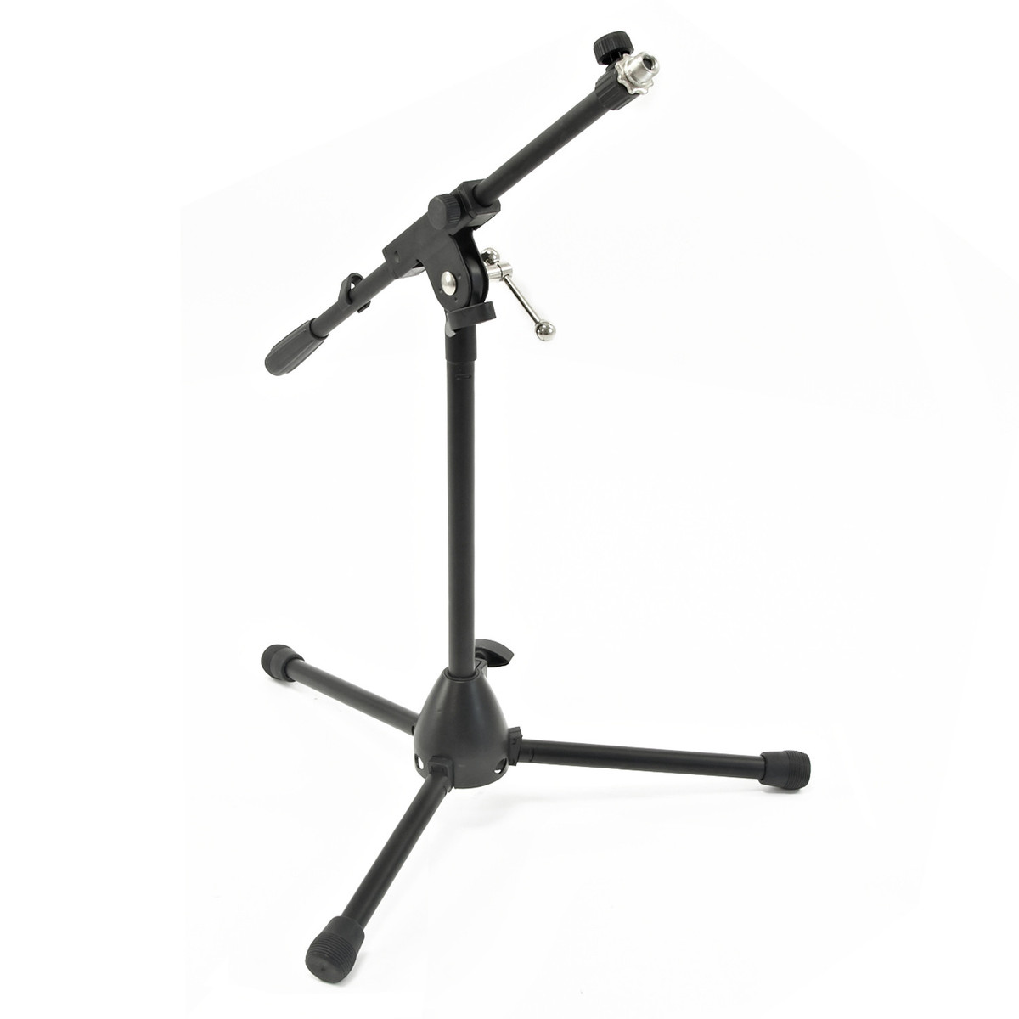
Mic Stands
Short Tripod Boom Stand
Good for mic-ing seated instruments without obstructing view of performer
Less Bulky
Good flexibility in terms of mic placement

Slide 32
Feedback
Some techniques for controlling feedback:
The speakers should be facing out towards the audience and should be in front of the stage
Microphones should remain behind the speakers
General volume adjust with gain knob during sound checks
After, adjust levels for sliders
Mute any unused microphones/channels
It is better to add volume for all channels by using the main output slider than raising each individual channel/microphone

Slide 33
Set Up!
Step 1: Set speakers up in the location you want them
Step 2: Connect Mixer to Power Source
Step 3 (Optional): If using an unpowered mixer, connect speakers to power source
Step 4: Connect speakers to “Main Out” (L/R) ports on sound board (either XLR, ¼” cables, or speak-on cable depending on board)
Step 5: Turn on sound mixer
Step 6 (optional): Turn on powered speakers
Step 7: Connect Microphones/Instruments to board inputs
Step 8: Adjust levels (turn up slider for main out, adjust levels on each channel)

Slide 34
I’m Set-Up but No Sound is Coming Out!
Checklist:
Are the mixer/speakers plugged in and turned on?
If they are plugged in to a power strip, is the power strip switched on?
Is everything plugged into the right spot?
Have I turned up the sliders on my outputs?
Have I assigned the channels I am using to a speaker?
Is the Channel Mute on?
Do I have a channel solo button selected on a different channel?
Is the gain and/or volume slider turned up on the channel I am using?
Does the microphone have a power switch? Is it turned on?
If I am using a condenser microphone, is phantom power turned on, on the sound board?
If I am using powered speakers, is the volume turned off on the back?

Slide 35
Troubleshooting Checklist
If you have completed the previous checklist, and are still not getting any sound, it’s time to troubleshoot!
Try a different channel on your sound board
Try using a different microphone
Try using a different Cable
If you are using a wireless microphone, make sure it is on the same band as the receiver
Check the signal indicator to see if any signal is being sent to the speakers

Slide 36
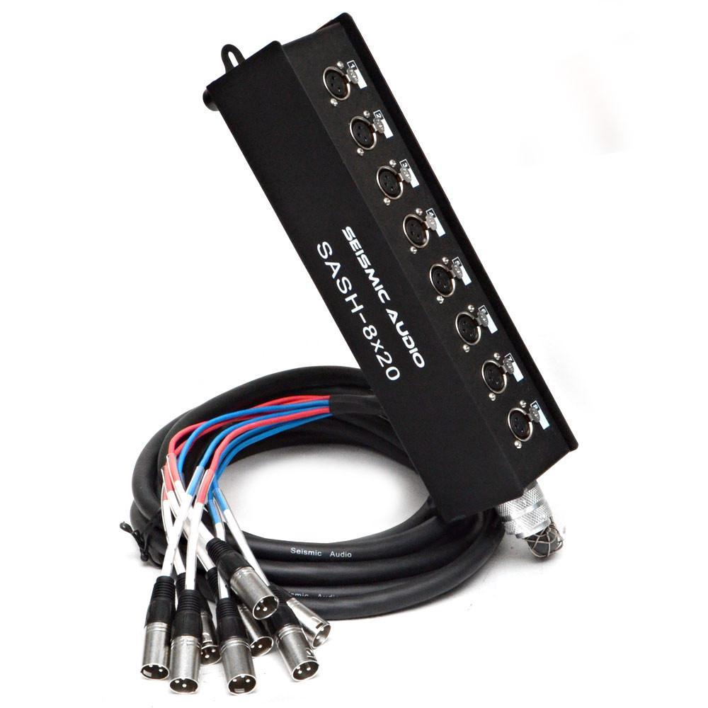
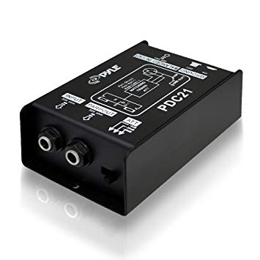
Miscellaneous Equipment
Snake
The “XLR Extension Chord”
Necessary for situations where the sound board is far away from the stage
DI Box
Used as a “splitter” which allows you to connect a guitar to both the amp (which will act as a monitor for the performer) and the sound board so you can adjust the amount of signal of the guitar being sent into the mix.
Works with bass guitar, keyboards, anything that uses a ¼” connection

Slide 37
Complete Starter Setup
Mackie ProFX8v2 Unpowered Mixer- $219.00
Rockville RPG122K Powered Speakers - $229.95
4 x 25’ XLR Cables - $40-$50
2 x 50’ XLR Cables - $30-$40
4 x microphone stands - $80 - $120
2 x Shure PGA58 vocal microphones - $108
1 x Samson C02PR stereo pair (2 mics) pencil condenser mic - $106
2 x 25” ¼” cables - $30
_____________________________________________________________________
Total: $843 - $903
This estimate is based on retail values. It does not take into account your school’s tax-exempt status and education discounts.

