Slide 1
(Day-O) The Banana Boat Song Harry Belafonte Traditional Jamaican Song STEAM Lesson
Dr. Leslie Merida – Gonzalez
Music Educator, Key Biscayne K-8 Center
Strings Orchestra, Band, Chorus, Music Theater

Slide 2
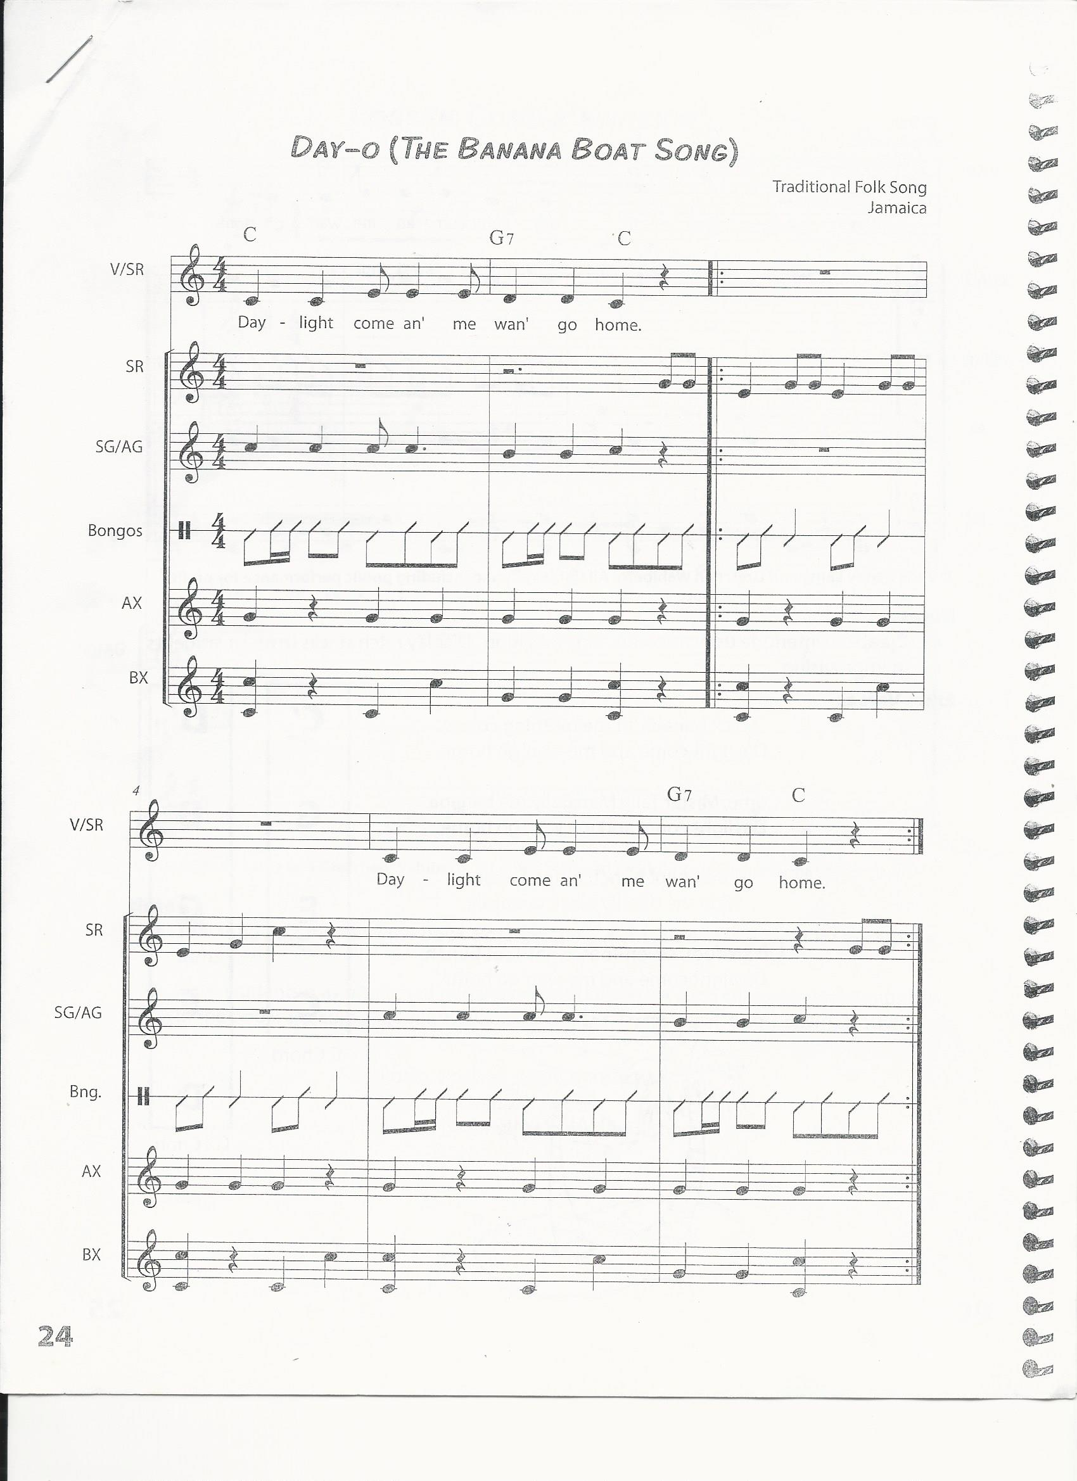
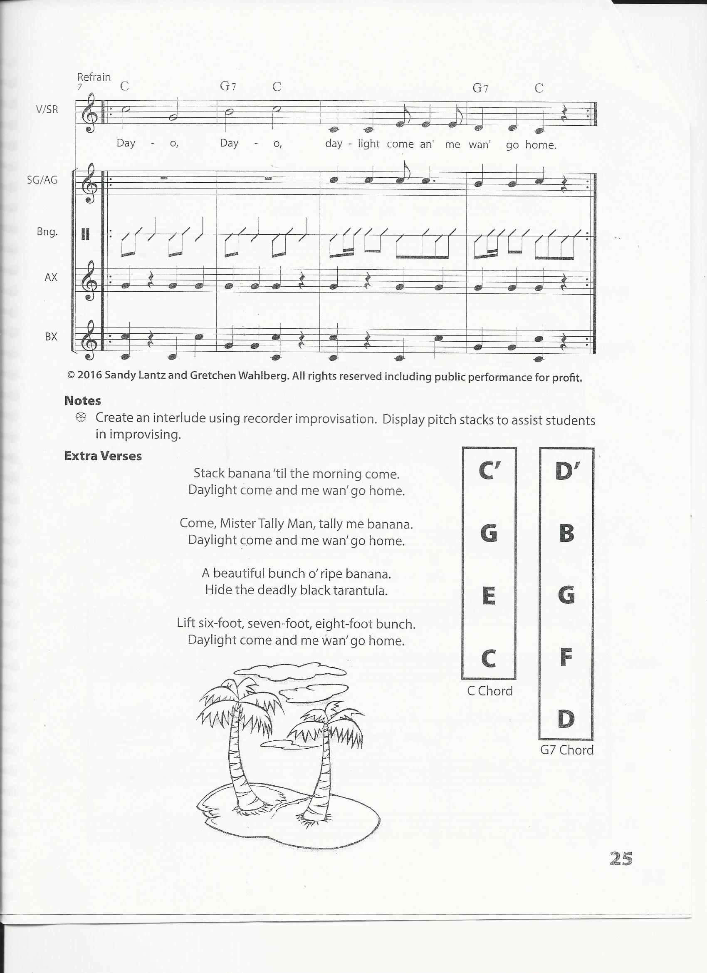

Slide 3
Standard-Driven Activity | STEAM 1.0 (Science) | STEAM 2.0 (Technology) | STEAM 3.0 (Engineering) | STEAM 4.0 (Arts) | STEAM 5.0 (Mathematics)
Banana Boat Song Compare and contrast insects to arachnids and learn internal and external parts of a spider. Create a spider web with specific measurements and geometrical shape. Conversion and Measurement. | Students will learn about the internal and external anatomy of spiders. Students will compare and contrast insects to arachnids. Organization and Development of Living Things SC.2.L.1.4 SC.2.L.1.7 Idea: Level 2 Basic Application of Skills and Concepts | Students will use technology to: review 12 times table. Identify and label the internal organs and the external body parts of a tarantula/spider. compare and contrast insects to arachnids. identify instruments in Calypso music and categorize them into their families. | Students will make a spider web and a spider with specific dimensions and weight. 12-inch Spider web shape: octagon 6-inch spider Measuring from head to spinneret. Spider web should be sturdy enough that can hold a spider that weighs 6-ounces. MAFS.2.MD.1.1. MAFS.2.G.1.3. | Students will sing Banana Boat Song with good intonation. MU.2.S.3.1 Students will create a pitched and un-pitched ostinato for the song. MU.2.S.1.2 Students will identify music instruments in Calypso music and categorize them into their families. MU.2.C.1.3 | Convert feet to inches using multiplication. Measurement and data: MAFS.2.MD.1.1 MAFS.2.MD.1.3 Solve Perimeter. Reason with shapes and their attributes Geometry: MAFS.2.G.1.3

Slide 4
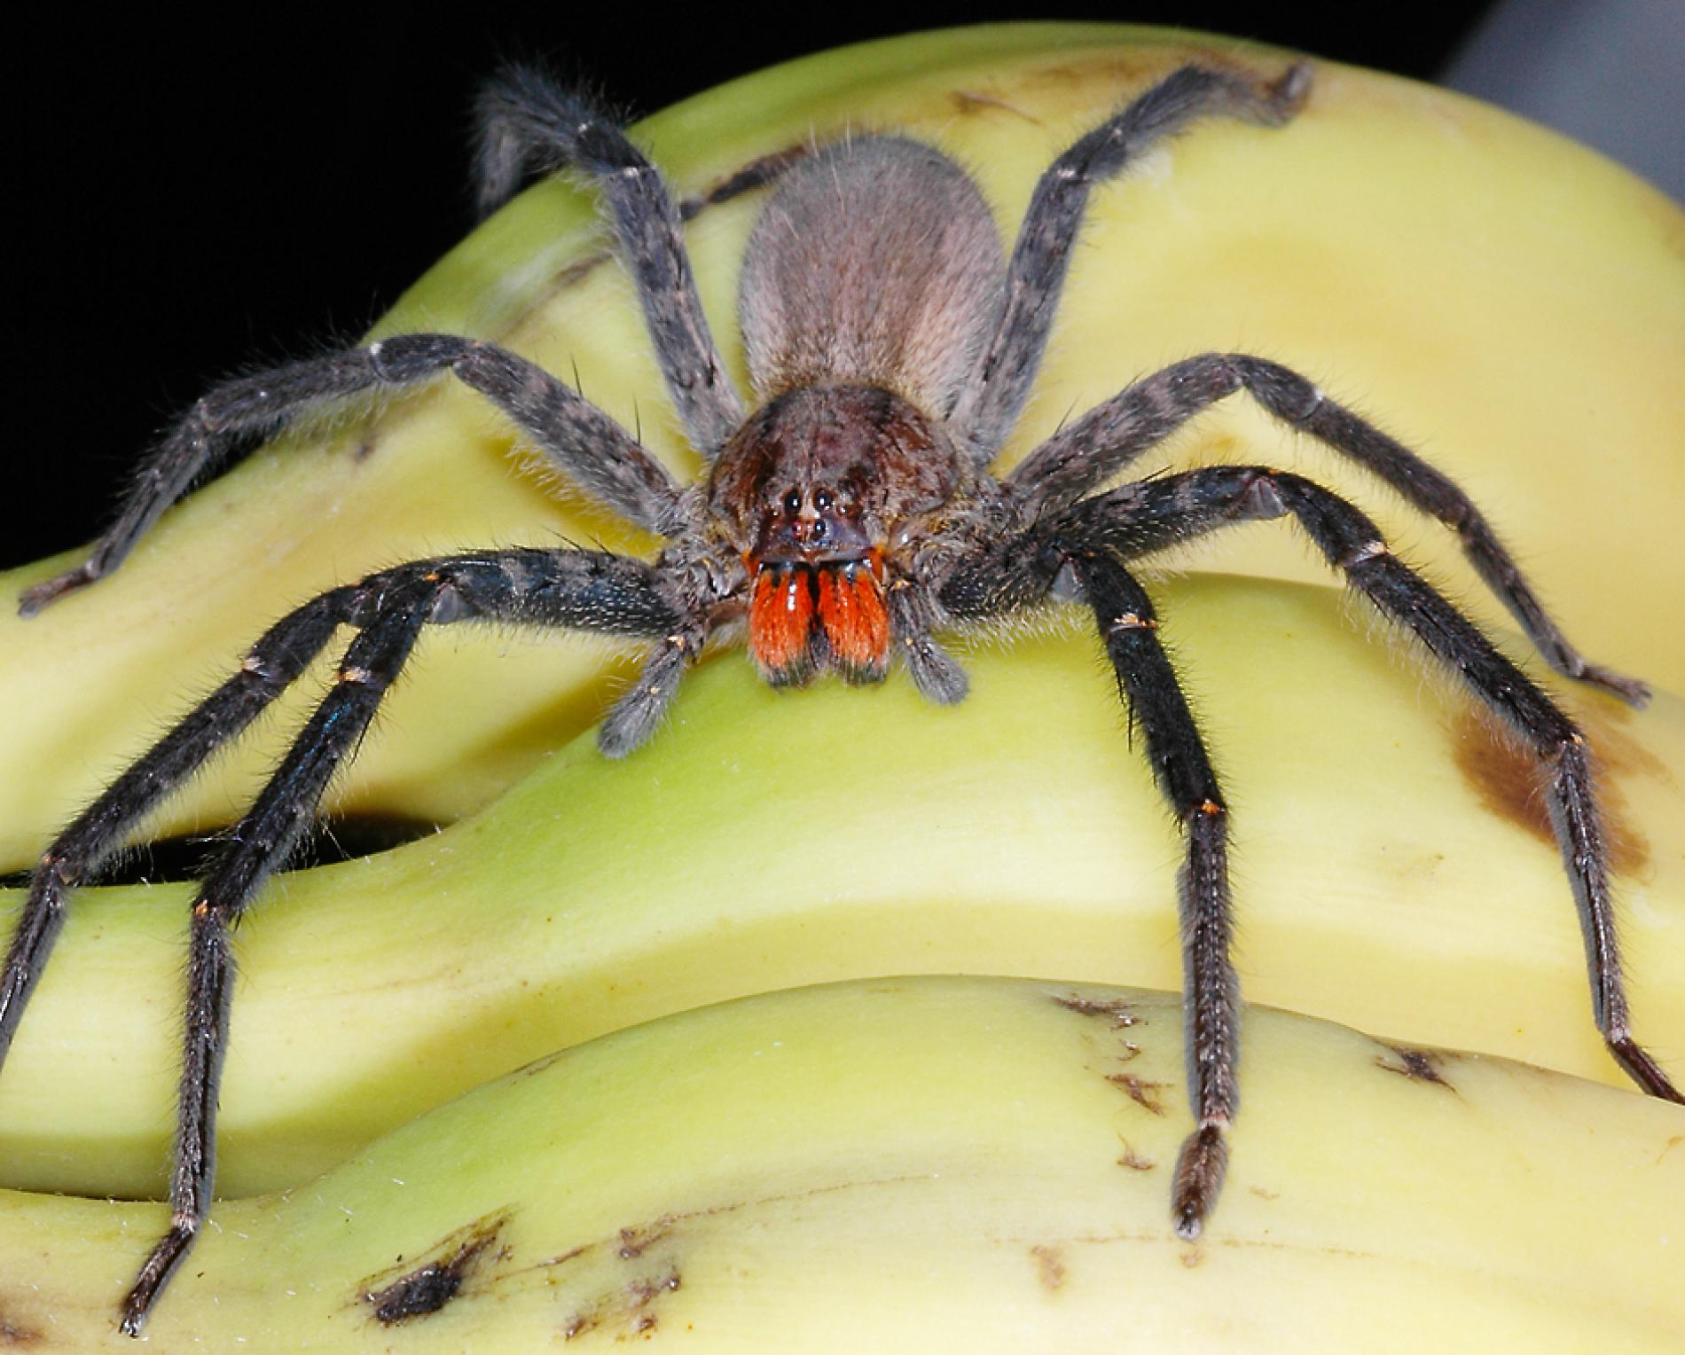
Hide the Deadly Black Tarantula!
2nd grade
Organization and Development of Living Things
SC.2.L.14
All plants and animals, including humans are alike in some ways and different in others.
All plants and animals, including humans, have internal parts and external structures that function to keep them alive and help them grow and reproduce.
Humans can better understand the natural world through careful observation.
SCIENCE

Slide 5
http://www.kidzone.ws/lw/spiders/facts-tarantula.htm

Slide 6
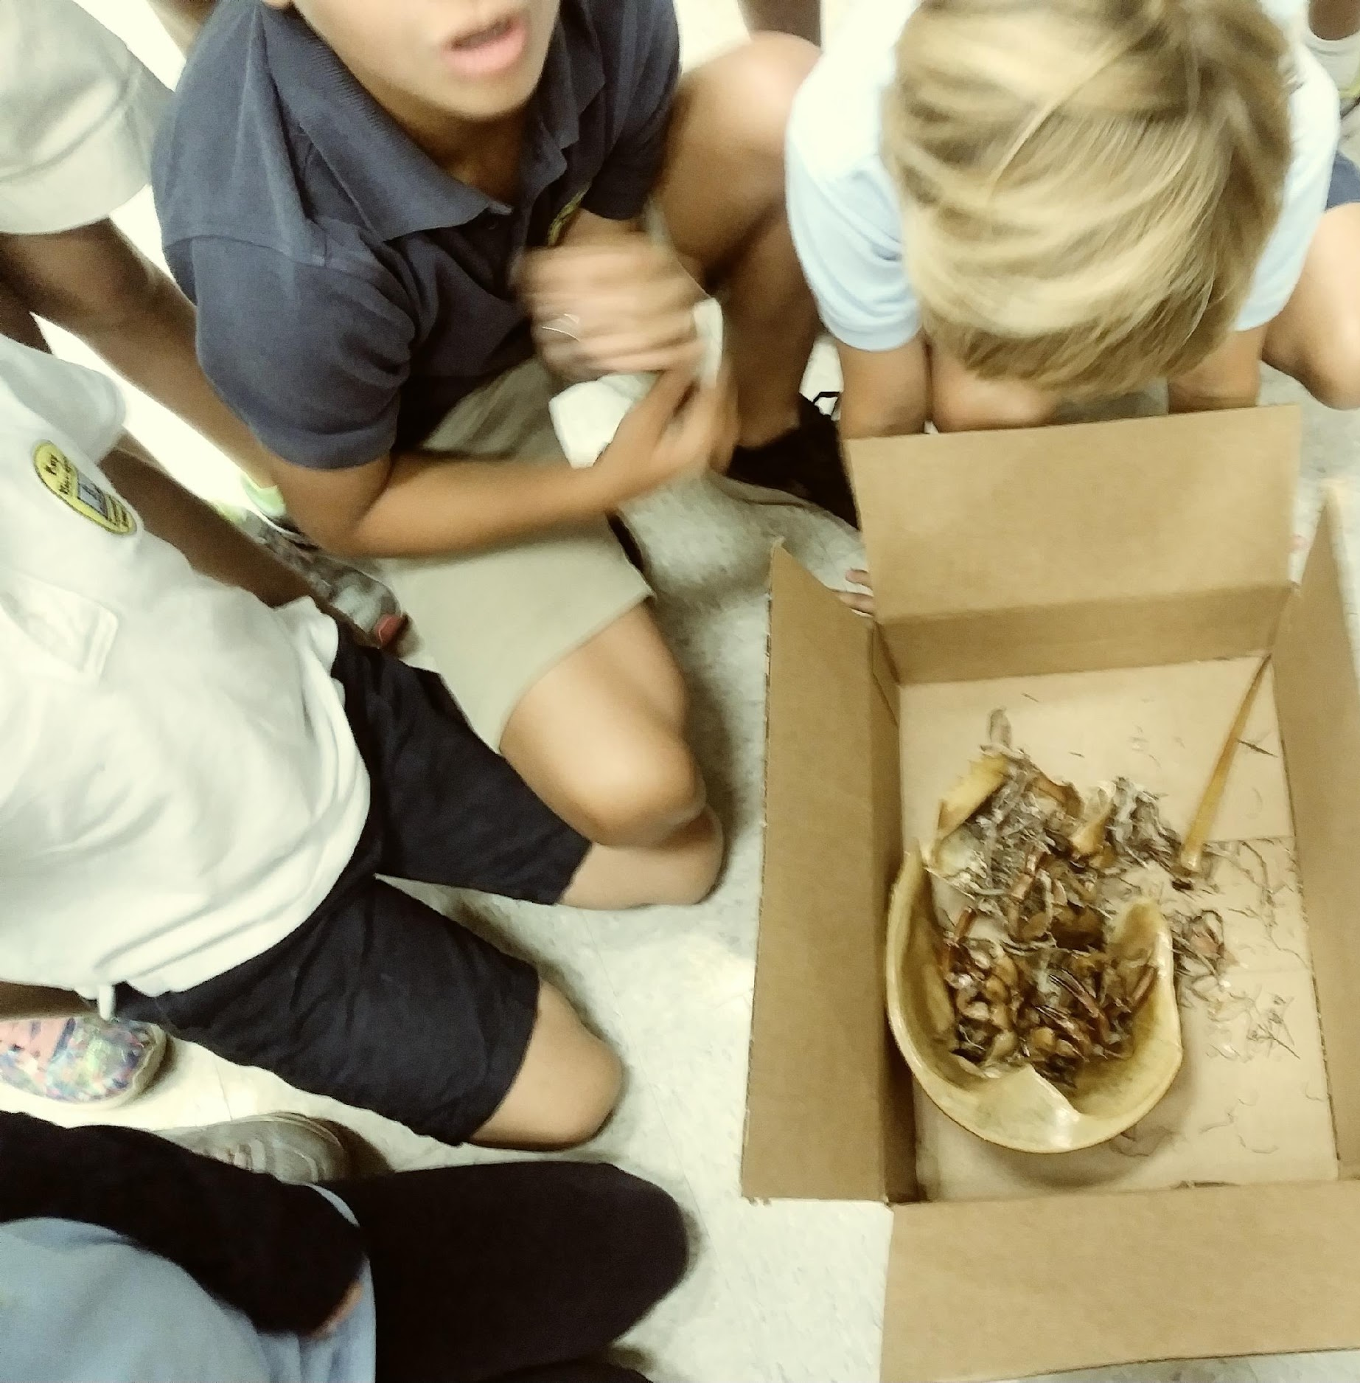
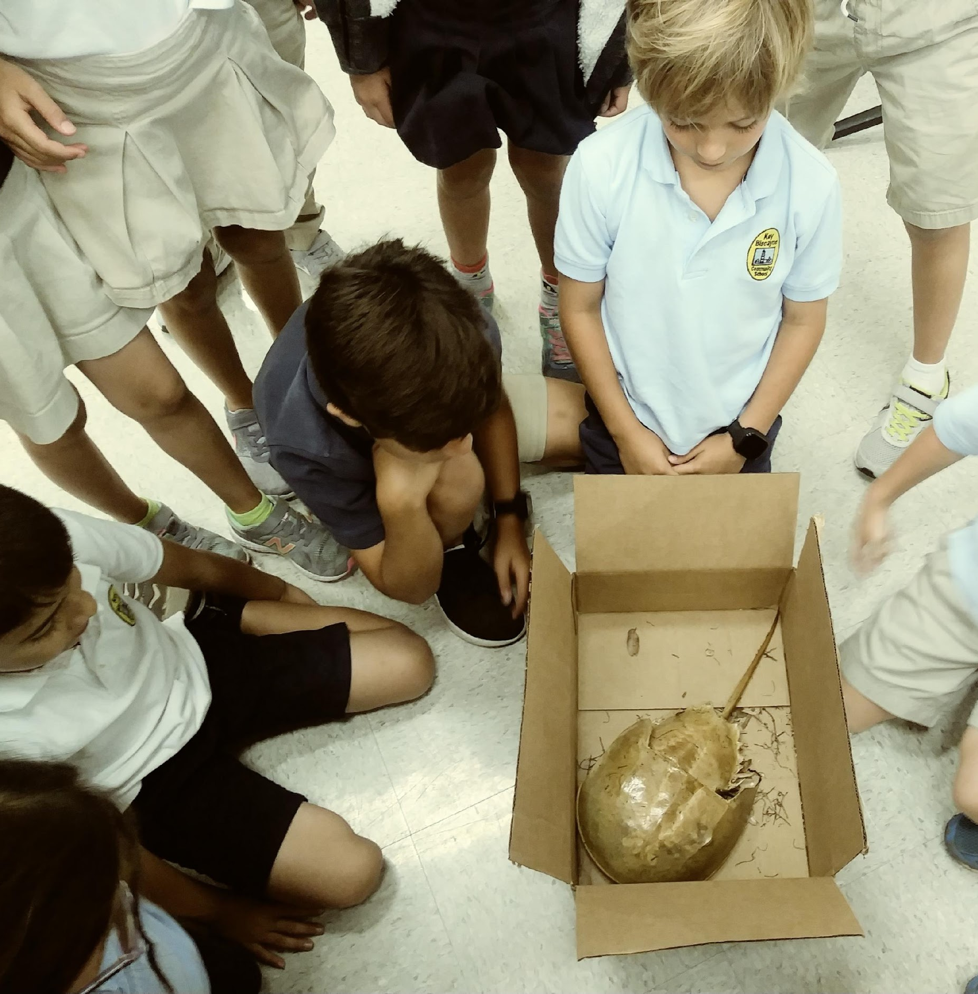

Slide 7
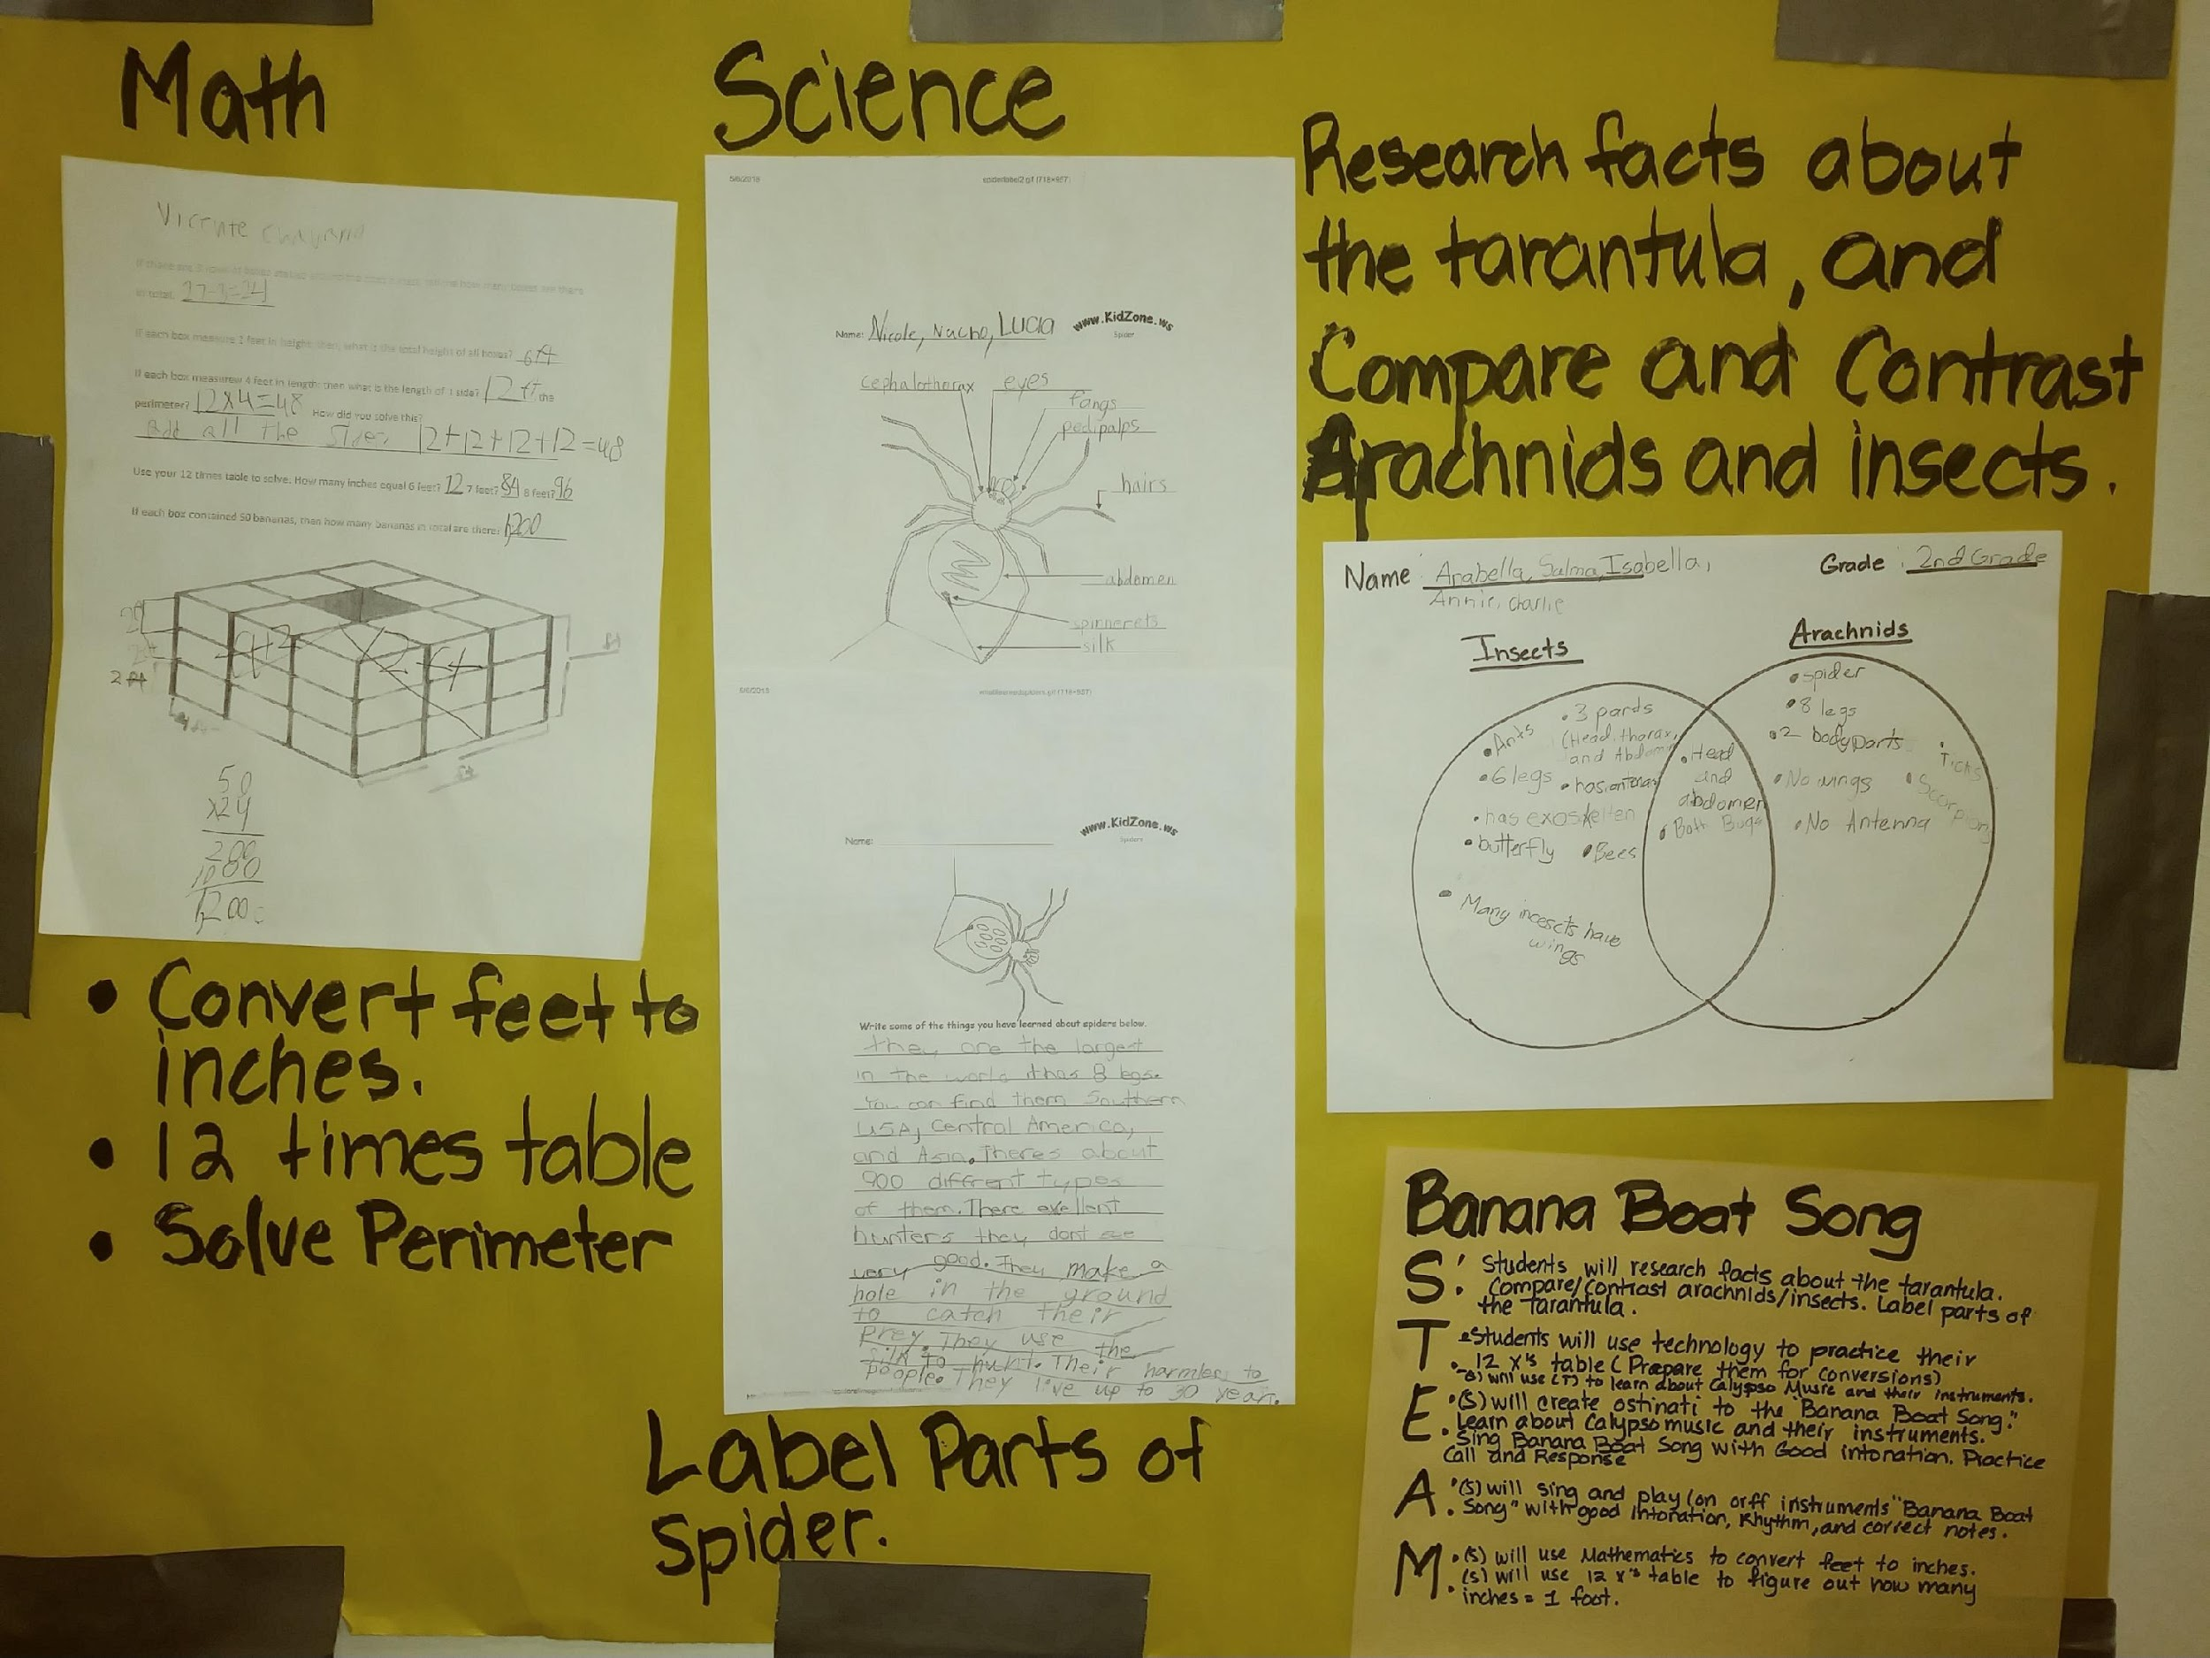
Comparing and Contrasting Insects to Arachnids

Slide 8
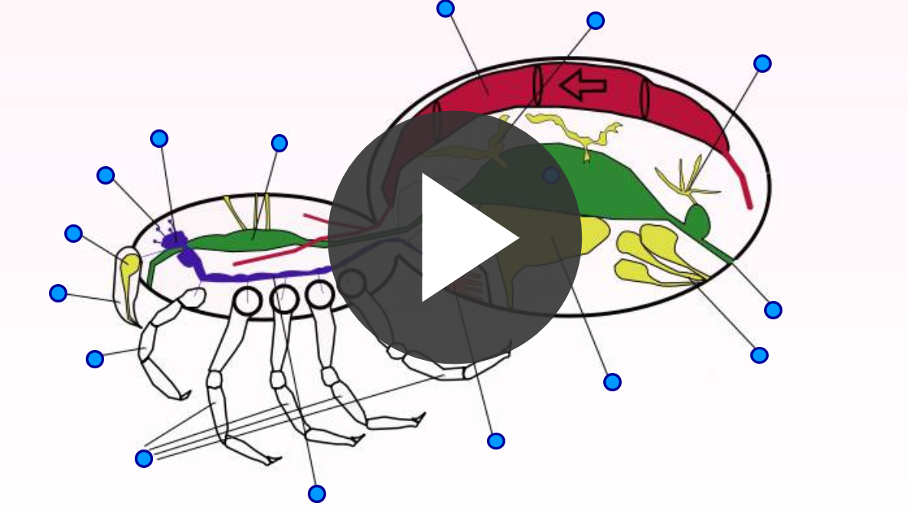
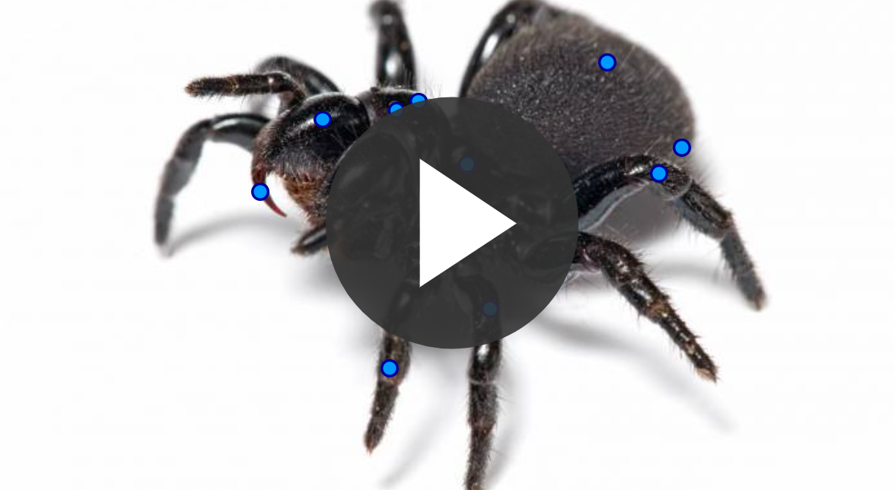
ANATOMY OF SPIDER: INTERNAL ORGANS AND DIAGRAM
TECHNOLOGY
https://www.purposegames.com/group/m-dcps-steam-elem-music-teachers/tournament-schedule

Slide 9
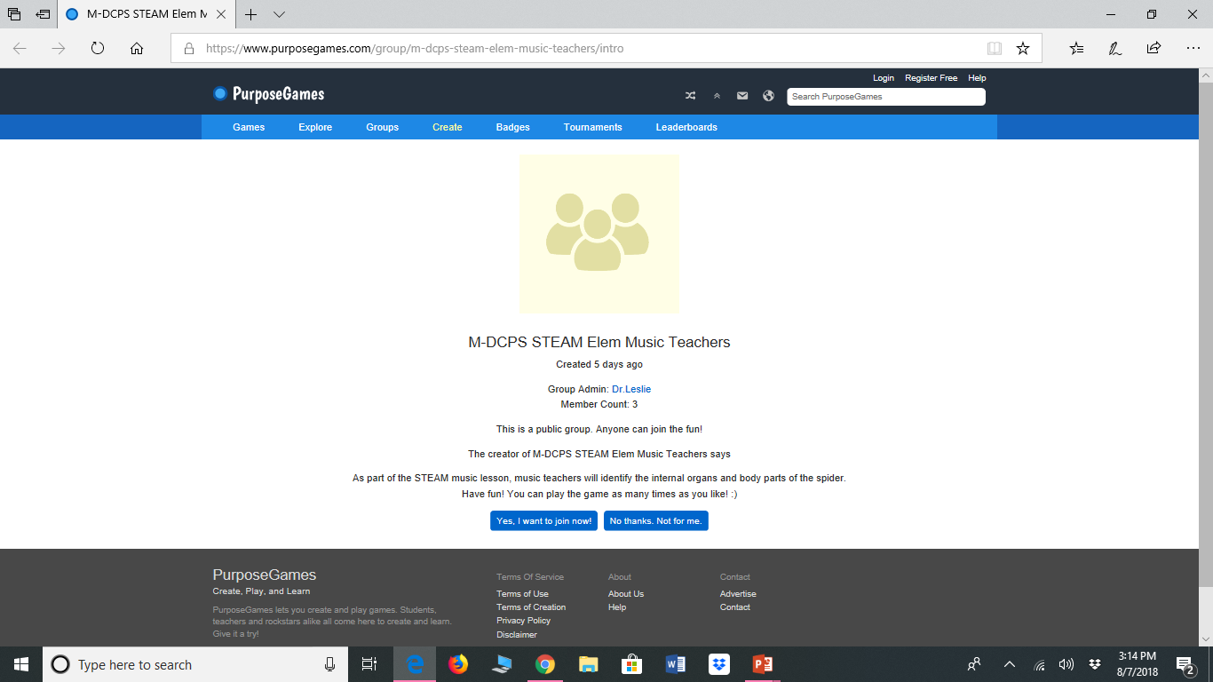
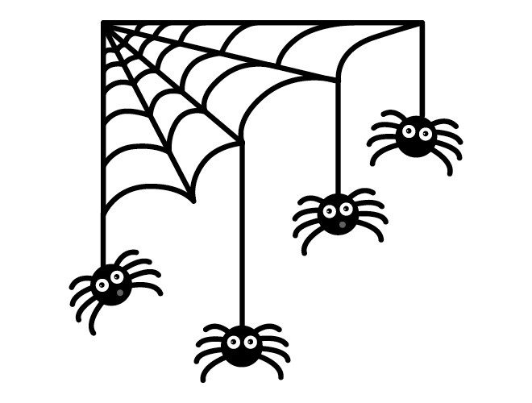
TECHNOLOGY ACTIVITY
Go to www.Purposegames.com
Top right hand corner click on REGISTER FOR FREE.
An activation link was sent to your email, click on that link.
Click on TOURNAMENTS.
Find STEAM Spiders and click on it.
Click on YES, I WANT TO JOIN
Now you are ready to play!

Slide 10
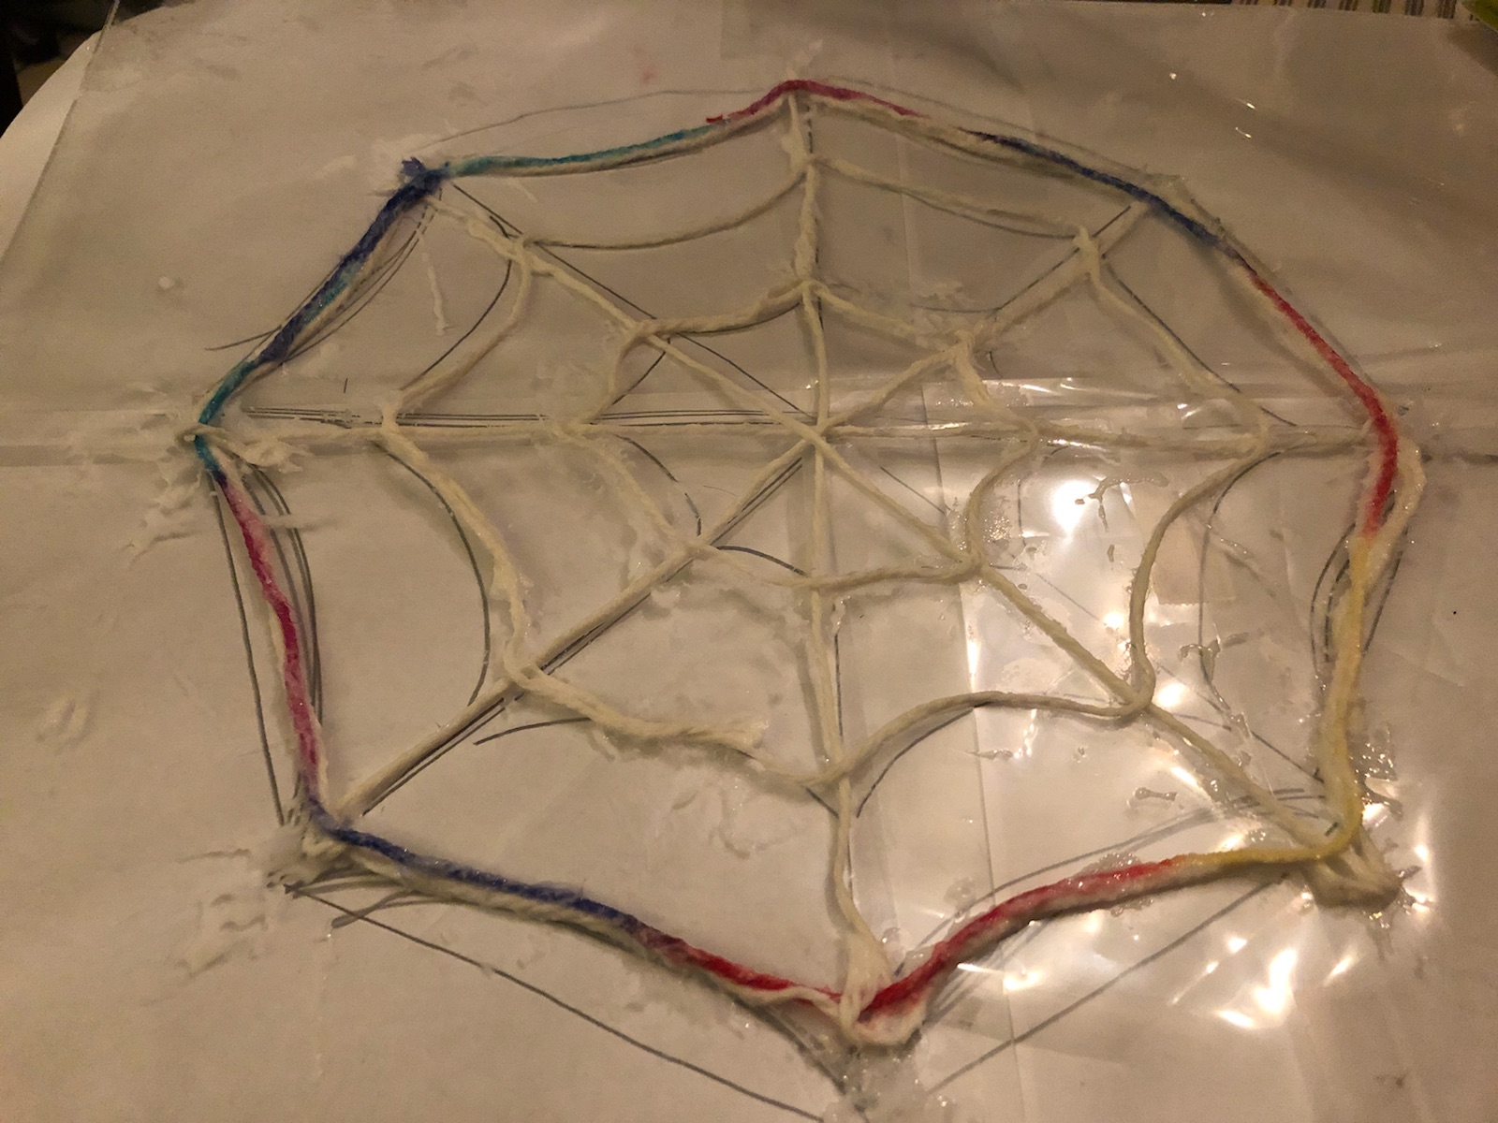
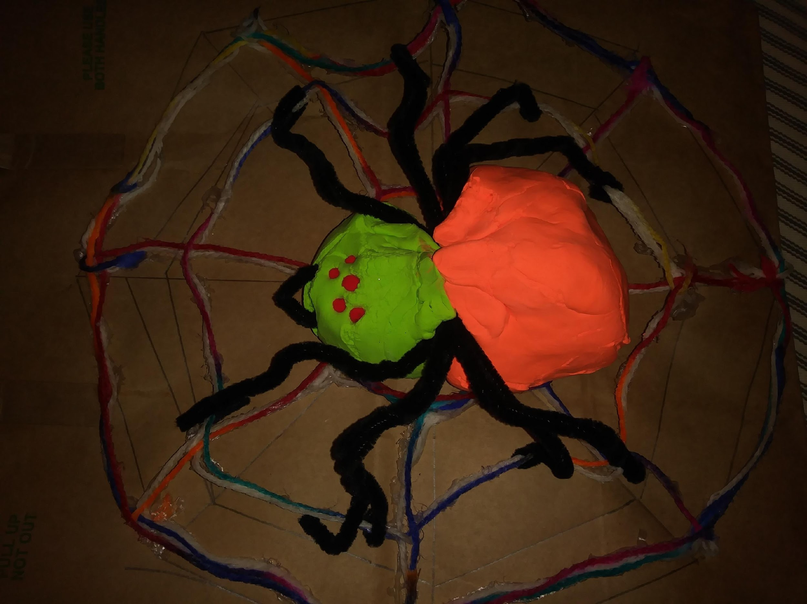
Students will make a spider web and a spider with specific dimensions and weight. Dimension: Spider Web Size:12-inch Shape: octagon. Spider Size: 6-inch spider. (measure from head to spinneret). Weight: 6-ounces. Spider web should be sturdy enough to hold a 6-ounce spider. CENTRAL QUESTION: Will the spider web be able to hold a six ounce spider? MAFS.2.MD.1.1. MAFS.2.G.1.3.
Spider Web Challenge
ENGINEERING

Slide 11
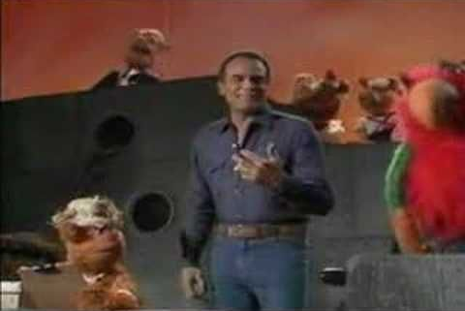
Banana Boat Song Meaning
“Day-O (The Banana Boat Song)" is an example of Calypso Music. It is a working folk song. The song tells the story of dock workers working the night shift loading bananas onto ships. Daylight has come, the shift is over, and they want their work to be counted (tallied) up so that they can go home.
ARTS

Slide 12
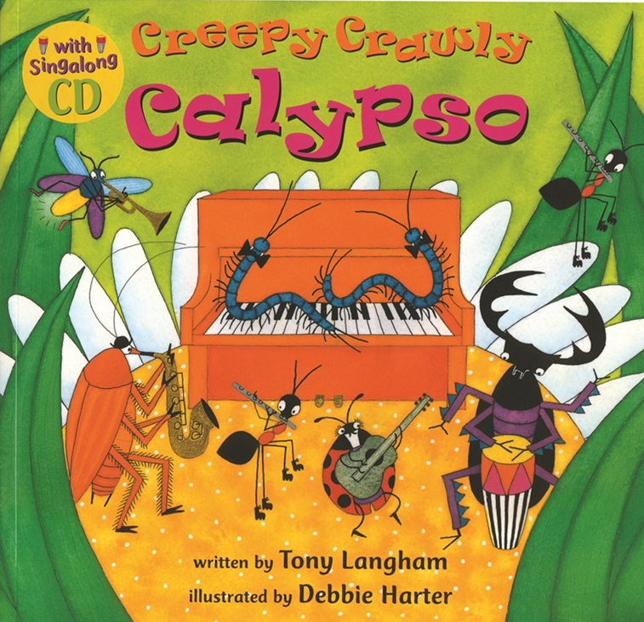
Calypso Music
Calypso is a style of Afro-Caribbean music that originated in Trinidad and Tobago during the early to mid-19th century. Calypso music was brought by African slaves imported to Caribbean islands to work on sugar plantations.

Slide 13
Calypso Music: Instruments
https://www.youtube.com/watch?v=f-EsQHr2TQ8
1. Tell me what music instruments are involved in Calypso music? __________________________________
3. What part of the world do you think Calypso music comes from? _________________________________
3. Tell me where in Miami would you go to listen to Calypso music? ________________________________
Directions: Listen to “Creepy Crawly Calypso” and categorize instruments into their families.
Strings
Woodwinds
Instruments
Brass
Percussion

Slide 14
Day-O (Banana Boat Song)
Day-o, Oh, Day-O (other times) Me, Me Say Day, Me Say Day, Me Say Day
Daylight come an’ we wan’ go home. (2 times) Daylight come an’ we wan’ go home. (2 times)
Stack banana ‘til the morning come.
Daylight come an’ we wan’ go home. (2 times)
Come Mister Tally Man, Tally me Banana.
Daylight come an’ we wan’ go home. (2 times)
A beautiful bunch o’ripe banana.
Hide the deadly black tarantula. (2 times)
Lift six-foot, seven-foot, eight-foot bunch.
Daylight come an’ we wan’ go home. (2 times)

Slide 16
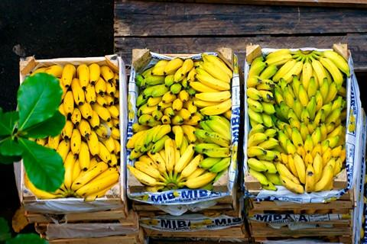
2nd grade
Reason with shapes and their attributes
Geometry: MAFS.2.G.1.3
Measure and estimate lengths in standard units
Measurement and data: MAFS.2.MD.1.1
MAFS.2.MD.1.3
.
Lift six-foot, seven-foot, eight-foot bunch!
Mathematics

Slide 17
Students used mathematics app online to practice their 12 times table.
https://www.timestables.com/12-times-table.html
Math concepts:
Review 12 times table online
Convert feet to inches using multiplication
Solve Perimeter

Slide 18
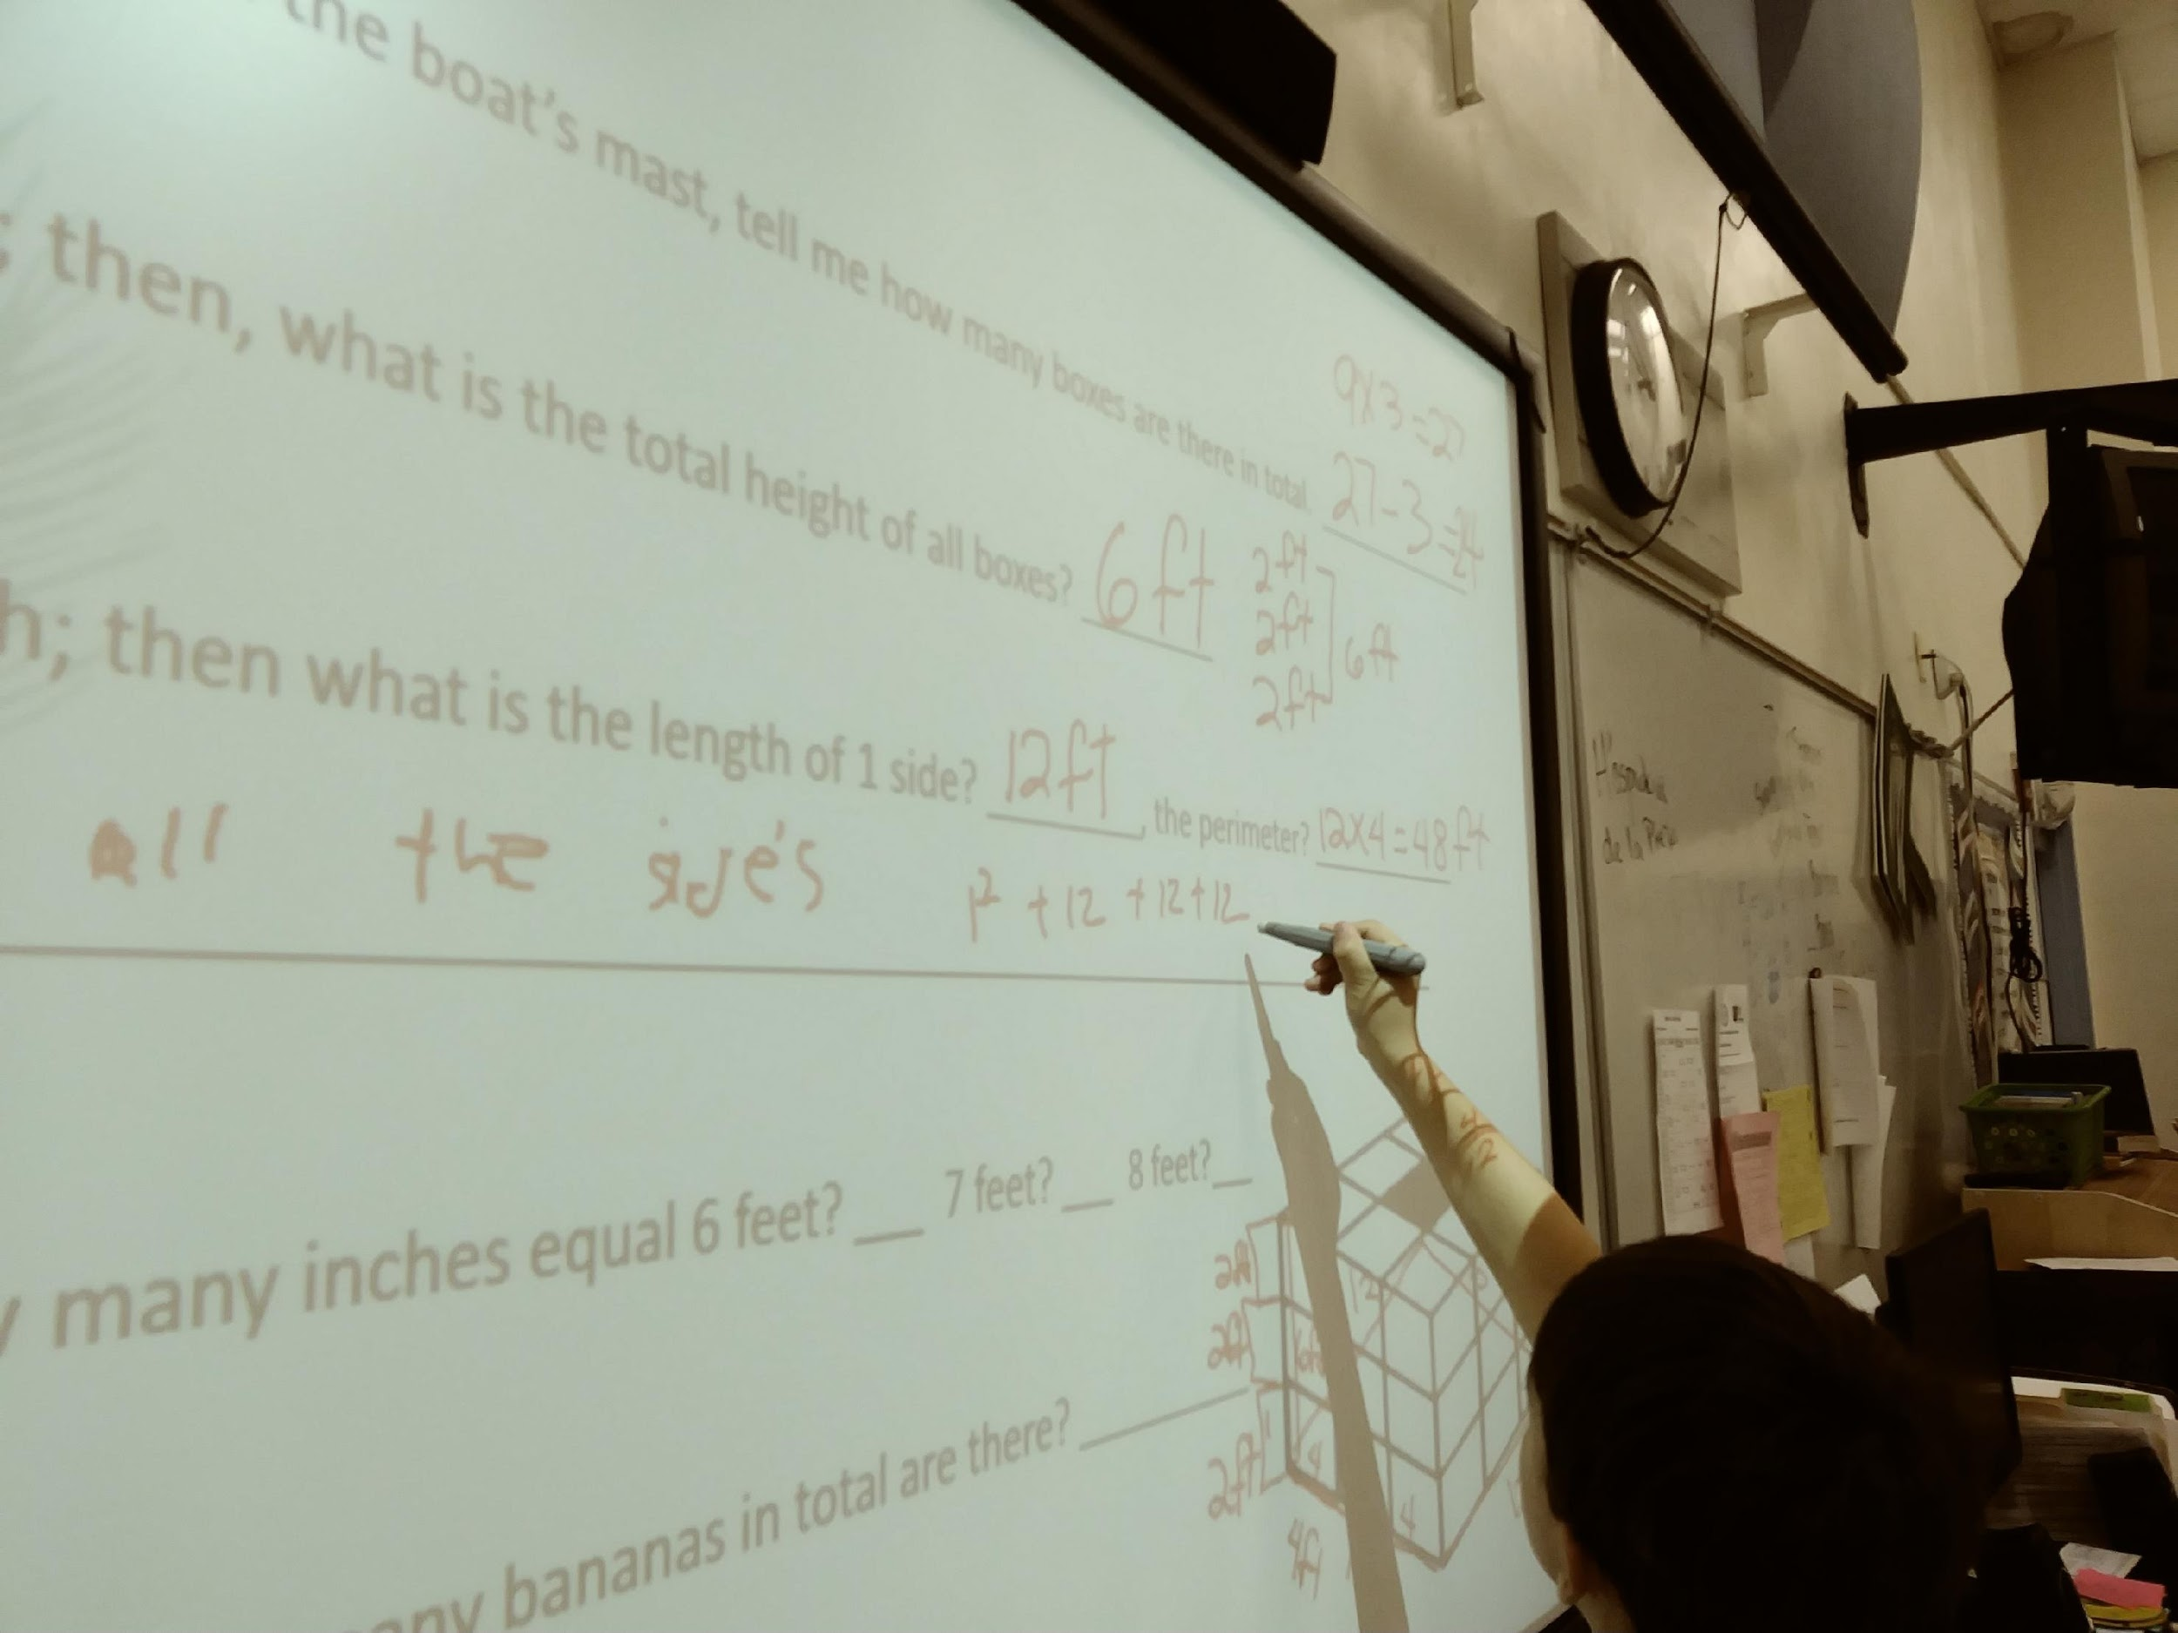
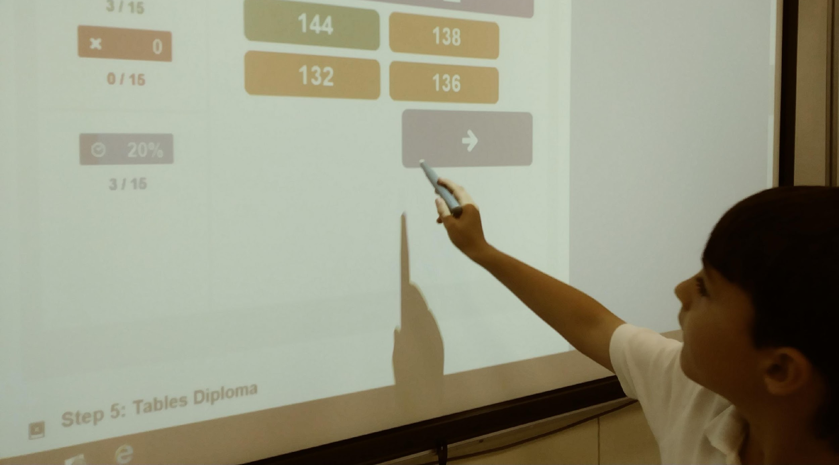

Slide 19
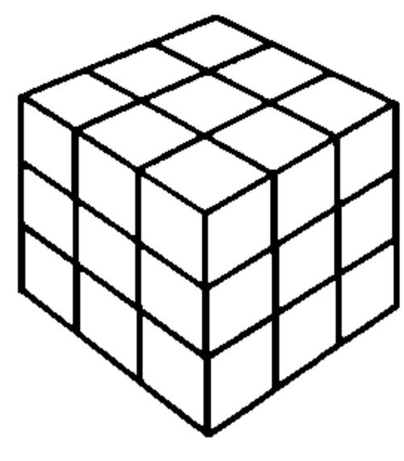
Math Word Problem:
If there are 3 rows of boxes staked around the boat’s mast, tell me how many boxes are there in total. ________________
If each box measure 2 feet in height; then, what is the total height of all boxes? _________
If each box measure 4 feet in length; then what is the length of 1 side? _________, the perimeter? ______________
How did you solve this? _________________________________________________________________________
Use your 12 times table to solve: How many inches equal 6 feet? ___ 7 feet? ___ 8 feet?___
If each box contained 50 bananas, then how many bananas in total are there? ___________

Slide 20
Standard-Driven Activity | STEAM 1.0 (Science) | STEAM 2.0 (Technology) | STEAM 3.0 (Engineering) | STEAM 4.0 (Arts) | STEAM 5.0 (Mathematics)
Banana Boat Song Compare and contrast insects to arachnids and learn internal and external parts of a spider. Create a spider web with specific measurements and geometrical shape. Conversion and Measurement. | Students will learn about the internal and external anatomy of spiders. Students will compare and contrast insects to arachnids. Organization and Development of Living Things SC.2.L.1.4 SC.2.L.1.7 Idea: Level 2 Basic Application of Skills and Concepts | Students will use technology to: review 12 times table. Identify and label the internal organs and the external body parts of a tarantula/spider. compare and contrast insects to arachnids. identify instruments in Calypso music and categorize them into their families. | Students will make a spider web and a spider with specific dimensions and weight. 12-inch Spider web shape: octagon 6-inch spider Measuring from head to spinneret. Spider web should be sturdy enough that can hold a spider that weighs 6-ounces. MAFS.2.MD.1.1. MAFS.2.G.1.3. | Students will sing Banana Boat Song with good intonation. MU.2.S.3.1 Students will create a pitched and un-pitched ostinato for the song. MU.2.S.1.2 Students will identify music instruments in Calypso music and categorize them into their families. MU.2.C.1.3 | Convert feet to inches using multiplication. Measurement and data: MAFS.2.MD.1.1 MAFS.2.MD.1.3 Solve Perimeter. Reason with shapes and their attributes Geometry: MAFS.2.G.1.3

Slide 21
Additional Science and technology lessons for older students: (E) Create a Jingle or advertisement for Chiquita Banana. https://www.chiquita.com/discover/campaigns (A) (T) Dramatize, sing, or play in instruments the Jingle and make it into a video. (A) Write a skit and create a short musical about Day-O, Banana Boat Song. (S) Learn about favorable weather and soil conditions to grow bananas besides Jamaica. https://www.chiquita.com/our-company/our-story (T) (M) Use Knowledge from (S). Tell students that although in the Banana Boat Song the bananas are from Jamaica, bananas also grow in other countries with ideal warm weather as Costa Rica and Honduras. Bananas are a tropical fruit, and all tropical fruit came into the USA through the port of Baltimore. Have students use the Xpeditions map, and trace the ports from Jamaica, Honduras, and Costa Rica to Baltimore. Use Sea-Distance.org to loop up ports. Calculate the sailing distance in miles between Jamaica and Baltimore, Honduras and Baltimore, and Costa Rica and Baltimore. Convert Knots into MPH. I Knot = 1.15078 MPH. Find the difference between the three voyages.

