Slide 1
Lesson Planning for Music Teachers
Ryan Gardner

Slide 2
Elementary Requirements
3 STEAM projects per year
One School-Based performance
One student in the Superintendent Honors Music Festival

Slide 3
Secondary Requirements
3 STEAM projects per year
One School-Based performance
One student in the Superintendent Honors Music Festival
One Performing Art Competition (MPA, Solo and Ensemble, FFMC, etc.)
One other visual OR performing arts competition

Slide 4
What is a STEAM 5.0 Lesson?
Fully incorporates all five components of STEAM
Grade Appropriate, Standard-driven lessons
Most lessons do not correctly implement technology and engineering

Slide 5
Finding Standards
www.cpalms.org
Sort by grade level and subject area
Easiest to search for key words using ctrl + f
Export to word document for easier visual reading

Slide 6
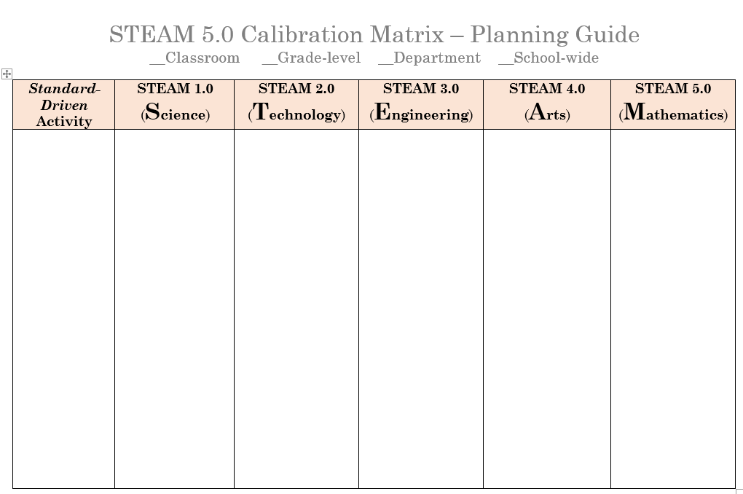
Rubric

Slide 7
Technology
Showing a video is not considered a correct use of technology
Sample uses:
Manipulative
Use of software
Interactive Simulations
Record keeping and sharing
Educational Social Media

Slide 8
Engineering
Experimental Process
Collaborative
NO PROCEDURES
Must provide a testable question

Slide 9
Third Grade Sample Rubric
Making a panpipe instrument with pvc pipes.
SC.3.P.10.2: Recognize that energy has the ability to cause motion or create change.
*SC.35.CS-CP.3.2: Present digitally created products, either individually or collaboratively…
Students will use the Digital Audio Workstation (DAW) “Audacity” to create a short recording of their instrument.
*VA.3.S.3.1: Use materials, and processes to achieve an intended result in two- and/or three-dimensional artworks.
Testable Question: Does the pitch of the pipes change if they become closed on one end?
MU.3.F.3.1: Collaborate with others to create a musical presentation and acknowledge individual contributions as an integral part of the whole.
MAFS.3.MD.2.4: Generate measurement data by measure lengths using rulers marked with halves and fourths of an inch. Show the data by making a line plot, where the horizontal scale is marked off in appropriate unites – whole numbers, halves, or quarters.
* - indicates non-required standards

Slide 10
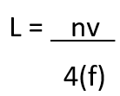
Sixth Grade Sample Rubric
Making a panpipe instrument with pvc pipes.
SC.6.P.11.1: Explore the Law of Conservation of Energy by differentiating between potential and kinetic energy. Identify situations where kinetic energy is transformed into potential energy and vice versa.
SC.68.CS-CC.1.2: Apply productivity and or multimedia tools for local and global group collaboration.
Students will use Audacity to create a recording of their instrument and use a “Bus” track to add reverb onto their recordings, while adjusting wet and dry mix.
VA.68.S.3.1:Use two-dimensional or three-dimensional art materials and tools to understand the potential and limitations of each.
Testable Question: In what way(s) does the material of the pipe affect the sound the instrument produces?
MU.68.S.1.1: Improvise rhythmic and melodic phrases to accompany familiar songs and/or standard harmonic progressions.
Students will use their created instruments to improvise over a C Blues Progression.
MAFS.6.EE.1.2: Write, read, and evaluate expressions in which letters stand for numbers.
Students will use the following equation to calculate the required lengths of each pipe for the following pitches: C3, D3, E3, G3, A4.

Slide 11
9-12 Grade Sample Rubric
Making a panpipe instrument with pvc pipes.
SC.912.N.1.5: Describe and provide examples of how similar investigations conducted in many parts of the world result in the same outcome.
SC.912.CS-PC.2.4: Analyze the positive and negative impacts of technology on popular culture and personal life.
Class discussion on the role of technology to produce and edit, advertise, and sell popular music.
Students will use Audacity to create a recording of their instrument and use a “Bus” track to add reverb onto their recordings, while adjusting wet and dry mix, as well as applying a high-pass filter to filter out unwanted lower frequencies.
VA.912.C.1.8: Explain the development of meaning and procedural choices throughout the creative process to defend artistic intention.
Testable Question: In what way(s) does the thickness of the pipe affect the instrument’s sound?
MU.912.S.1.1: Improvise rhythmic and melodic phrases over harmonic progressions.
Students will use their created instruments to improvise over a C Blues Progression.
MAFS.912.N-Q.1.3: Choose a level of accuracy appropriate to limitations on measurement when reporting quantities.
Students will use two separate equations to calculate pitch of musical notes as well as length of pipes required, rounding to two decimal places, to pinpoint the level of accuracy needed when measuring and cutting pipes.

