Slide 1
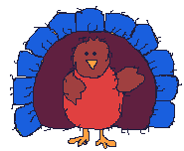
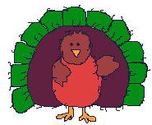
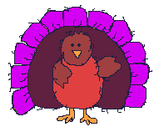
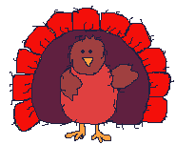
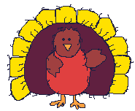
FIVE FAT TURKEYS
Jessica Suchecki

Slide 2
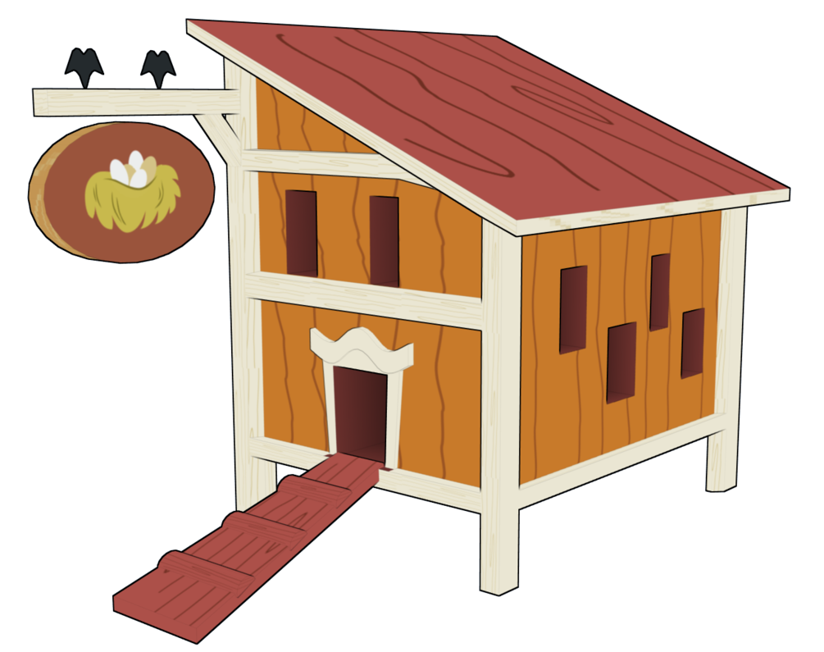
Five fat turkeys are we

Slide 3
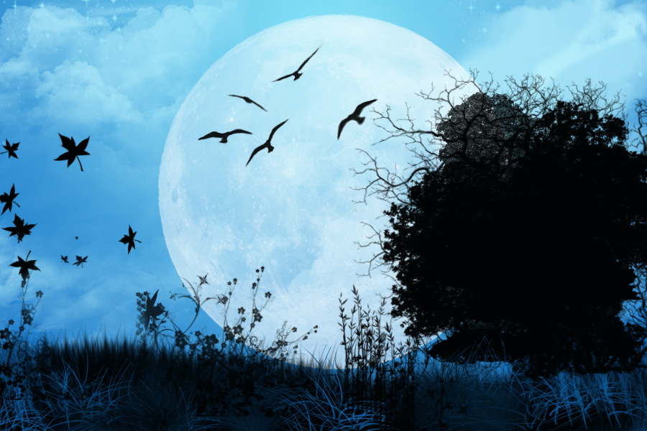
We slept all night
in a tree

Slide 4
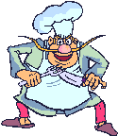
When the cook came around
we couldn’t be found

Slide 5
So, that’s why we’re
here you see!

Slide 6
DANCE BREAK
Turn with your partner- 8 Counts
Turn the other way- 8 Counts
Body Percussion:
Note: You can do this body percussion for the intro! For the outro do only measures 3-4.

Slide 7
Five fat turkeys are we

Slide 8
We slept all night
in a tree

Slide 9
When the cook came around
we couldn’t be found

Slide 10
So, that’s why we’re
here you see!

