Slide 1
Back To Basics
Foundational practices for success in the Elementary General Music Classroom

Slide 2
Why Do We Teach elementary General Music?
Provide students with a positive experience making music!!
The positive experience we provide leads to a lifelong appreciation for the arts.

Slide 3
General music VS. Elementary ENsembles
General Music
Elementary ensembles
Students explore all aspects of music.
Skill building with no pressure to perform.
Students progress in a variety of ways.
With pressures to perform, there is less emphasis on making music in a variety of ways.
Can be stressful.

Slide 4
Characteristics of young children
They are active learners – they must EXPERIENCE or DO something!
They learn through repetition.
They are concrete rather than abstract.
They need routine and structure.

Slide 5
Curriculum for young children
Build a repertoire of songs.
Encourage/facilitate numerous movement activities.
Encourage melodic and rhythmic vocabulary.
Develop many aural discrimination activities.

Slide 6
In other words, each lesson should feature the following:
Literacy
Singing
Movement
Instrumental/Readiness
Listening

Slide 7
Literacy – The Gordon Method (Adapted)
Modeled after principles of language acquisition
Separates Rhythmic and Tonal Development

Slide 8
Levels of Learning: Both Tonal and Rhythmic Development
Sensory or Perceptual Functioning (Joyce Jordan)
Discrimination Levels
(Edwin Gordon)
Experience sounds through the senses.
Label sounds
Recognize sounds aurally
Symbolize sounds
Recognize symbols for sounds
Aural/Oral
Verbal Association
Partial Synthesis
Symbolic Association
Composite Synthesis

Slide 9
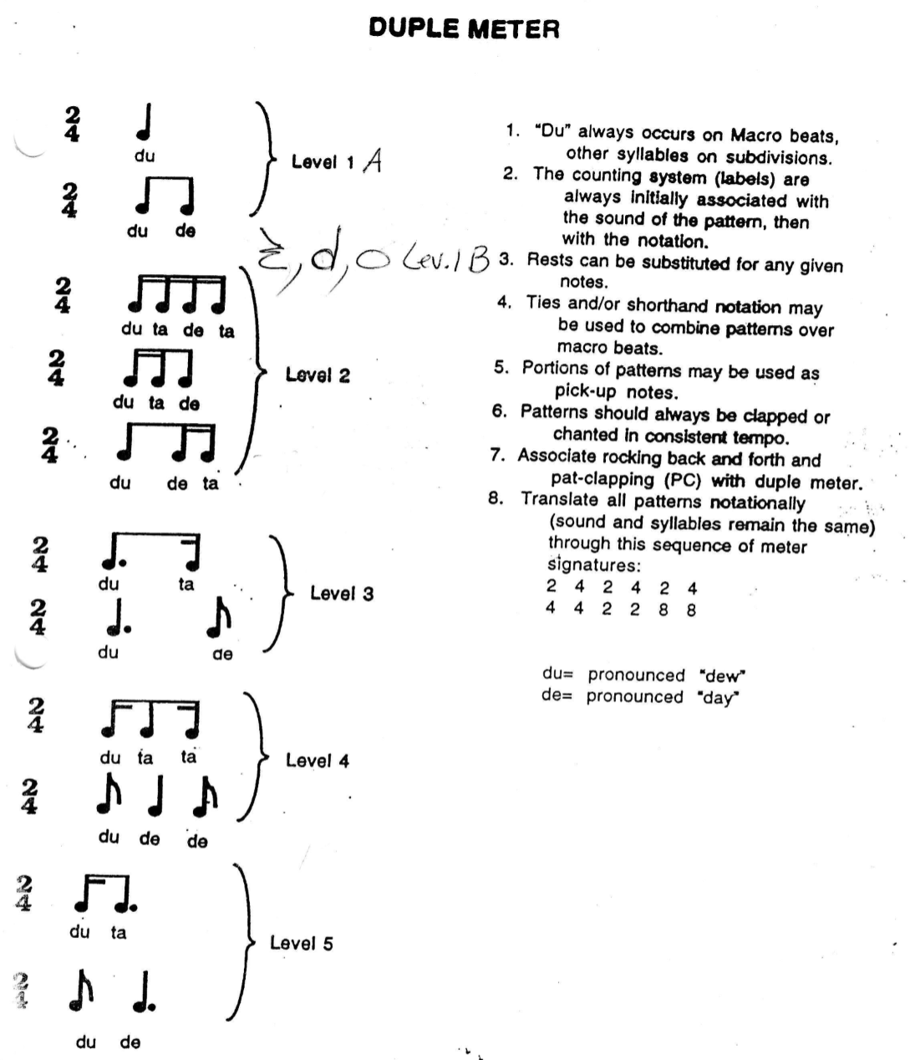

Slide 10
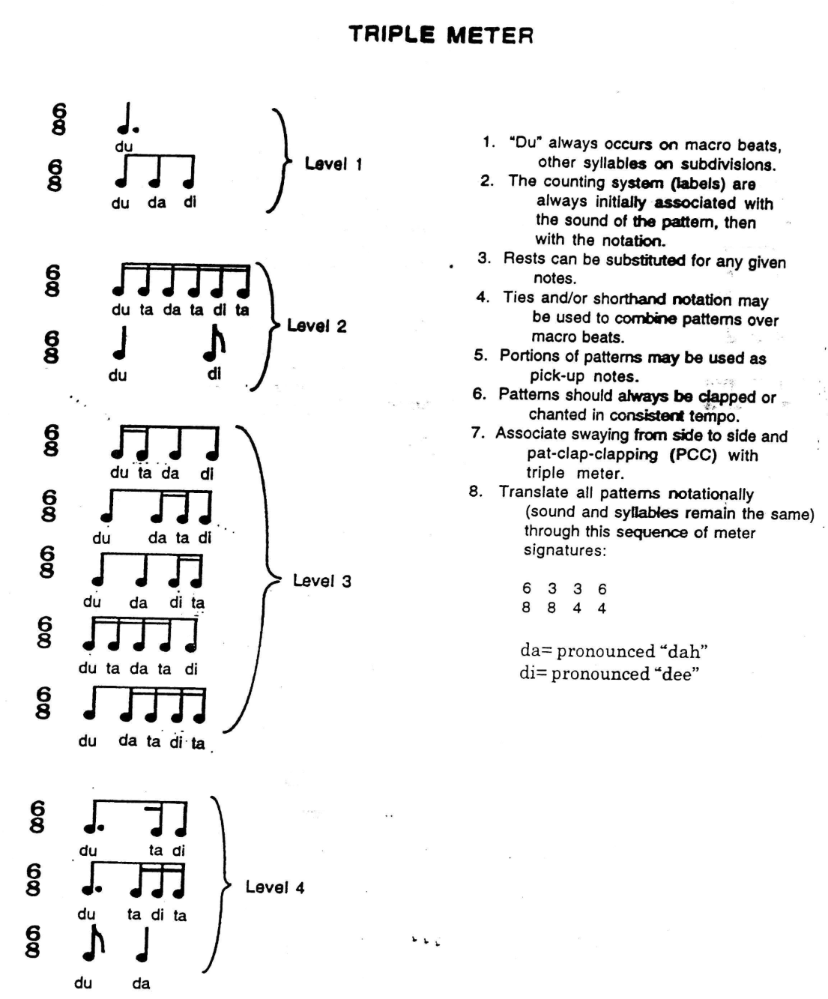

Slide 11
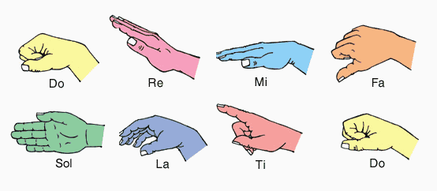

Slide 12
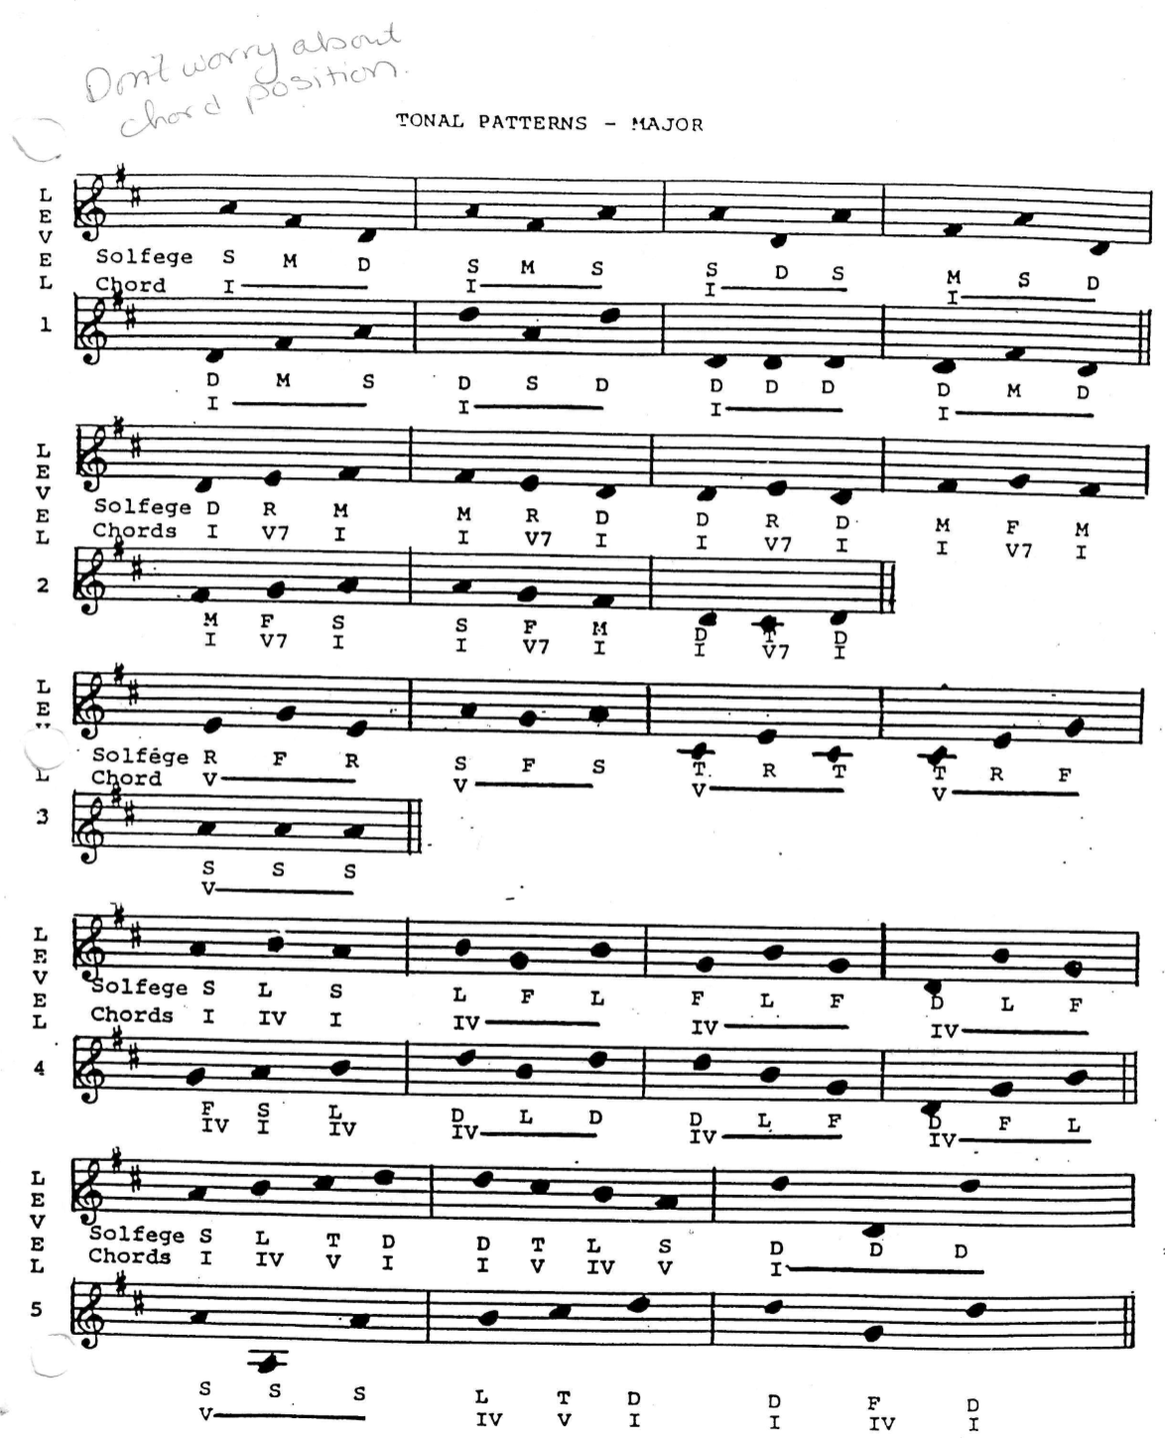

Slide 13
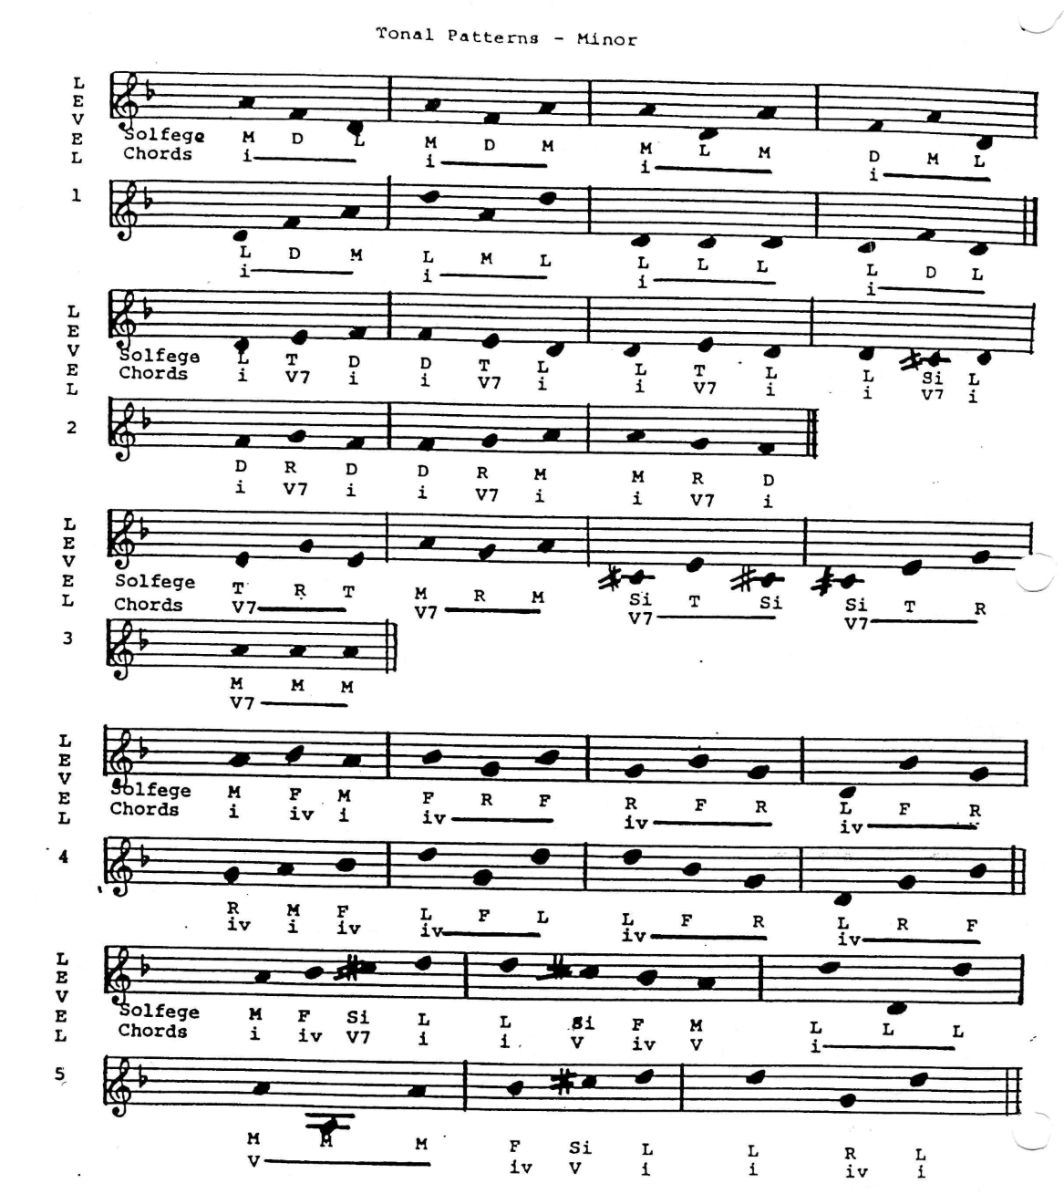

Slide 14
Things to Remember…
Reciting patterns should take place during every lesson.
Reciting patterns should take no more than 5 minutes every lesson!
Feel free to incorporate pre-notation as much as possible. Always take them from known-to-unknown.
Reading is a process, not an all-in-one thing! Only show them what they need to know/what they will DO!
Try not to explain – EXPERIENCE AND DO!!!

